Slide 1
Next-generation compilers for emerging systems
Jeronimo Castrillon
Chair for Compiler Construction (CCC), TU Dresden,
SCADS.AI Dresden/Leipzig & Center for Advancing Electronics (cfaed) Dresden
Keynote: Workshop on Compilers, Deployment, and Tooling for Edge AI (CODAI’23)
Hamburg, Germany
September 21, 2023
Notes:
40 minutes (including Q&A)
Programming heterogeneous computing systems is a daunting task that just became more challenging with emerging, non Von-Neumann computer architectures. Innovation in programming abstractions and compilers are thus badly needed to cope with the current golden age of computer architecture. This talk discusses domain-specific abstractions and languages as a promising avenue to hide the system complexity from non-expert programmers while passing richer information to compilers. Concretely, we will discuss abstractions for tensor expressions and machine learning in general, with insight into compilation for adaptable inference at the edge. The talk then describes emerging (in and near-memory) accelerators and ongoing efforts to build programming flows for them.

Slide 2
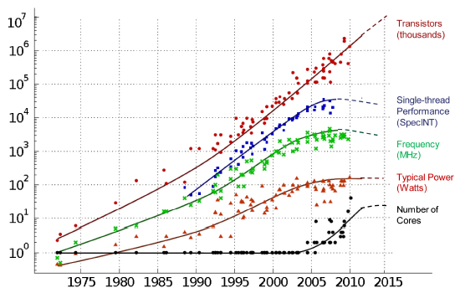
Evolution of computing: Breaking walls
Transistors
(thousands)
Post CMOS, non Von Neumann
Dark Si:
specialize
Multi-core
architectures
Single-thread
Performance
Single-core
architectures
Frequency
(MHz)
~2005
Typical power
(W)
J. Castrillon, et al. "A Hardware/Software Stack for Heterogeneous Systems", In IEEE Transactions on Multi-Scale Computing Systems, vol. 4, no. 3, pp. 243-259, Jul 2018.
Core count
M. Horowitz, F. Labonte, et al. Dotted-line by C. Moore, “Data processing in exascale-class computer systems,” The Salishan Conference on High Speed Computing, 2011
Notes:
First point: Inflections in computing
AI chips, also with emerging memristive tehcs, or in-memory computing like in N3xt from Stanford.

Slide 3
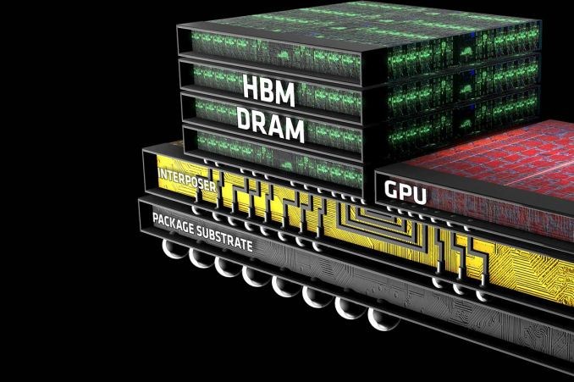
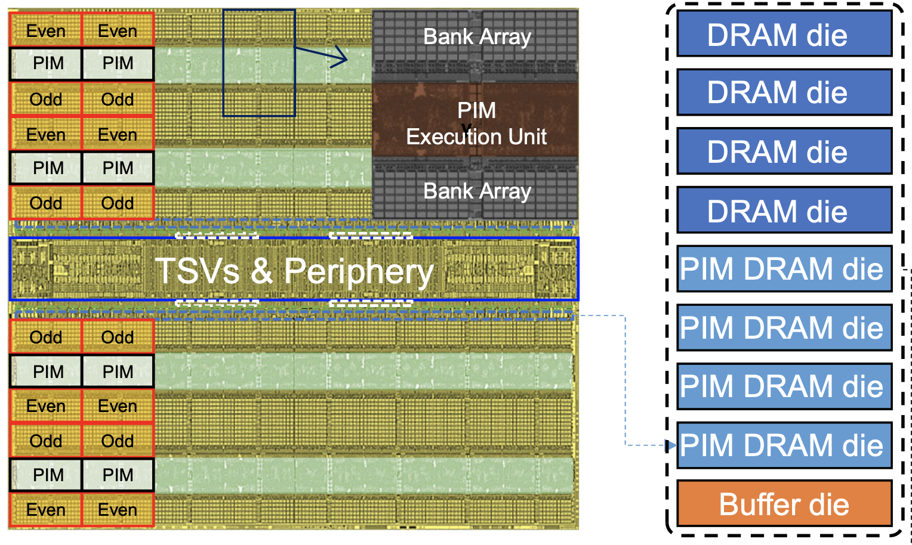
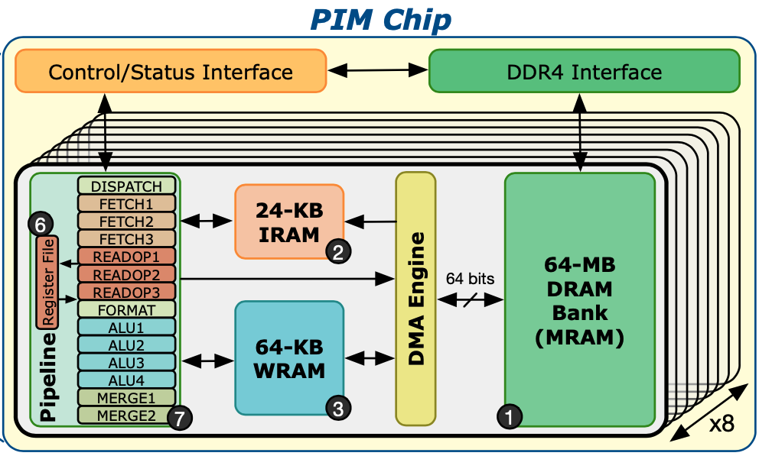
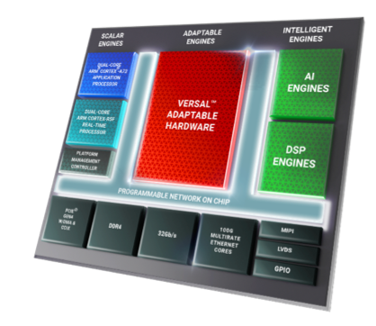
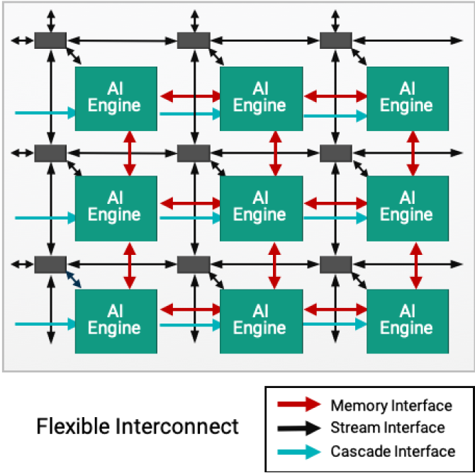
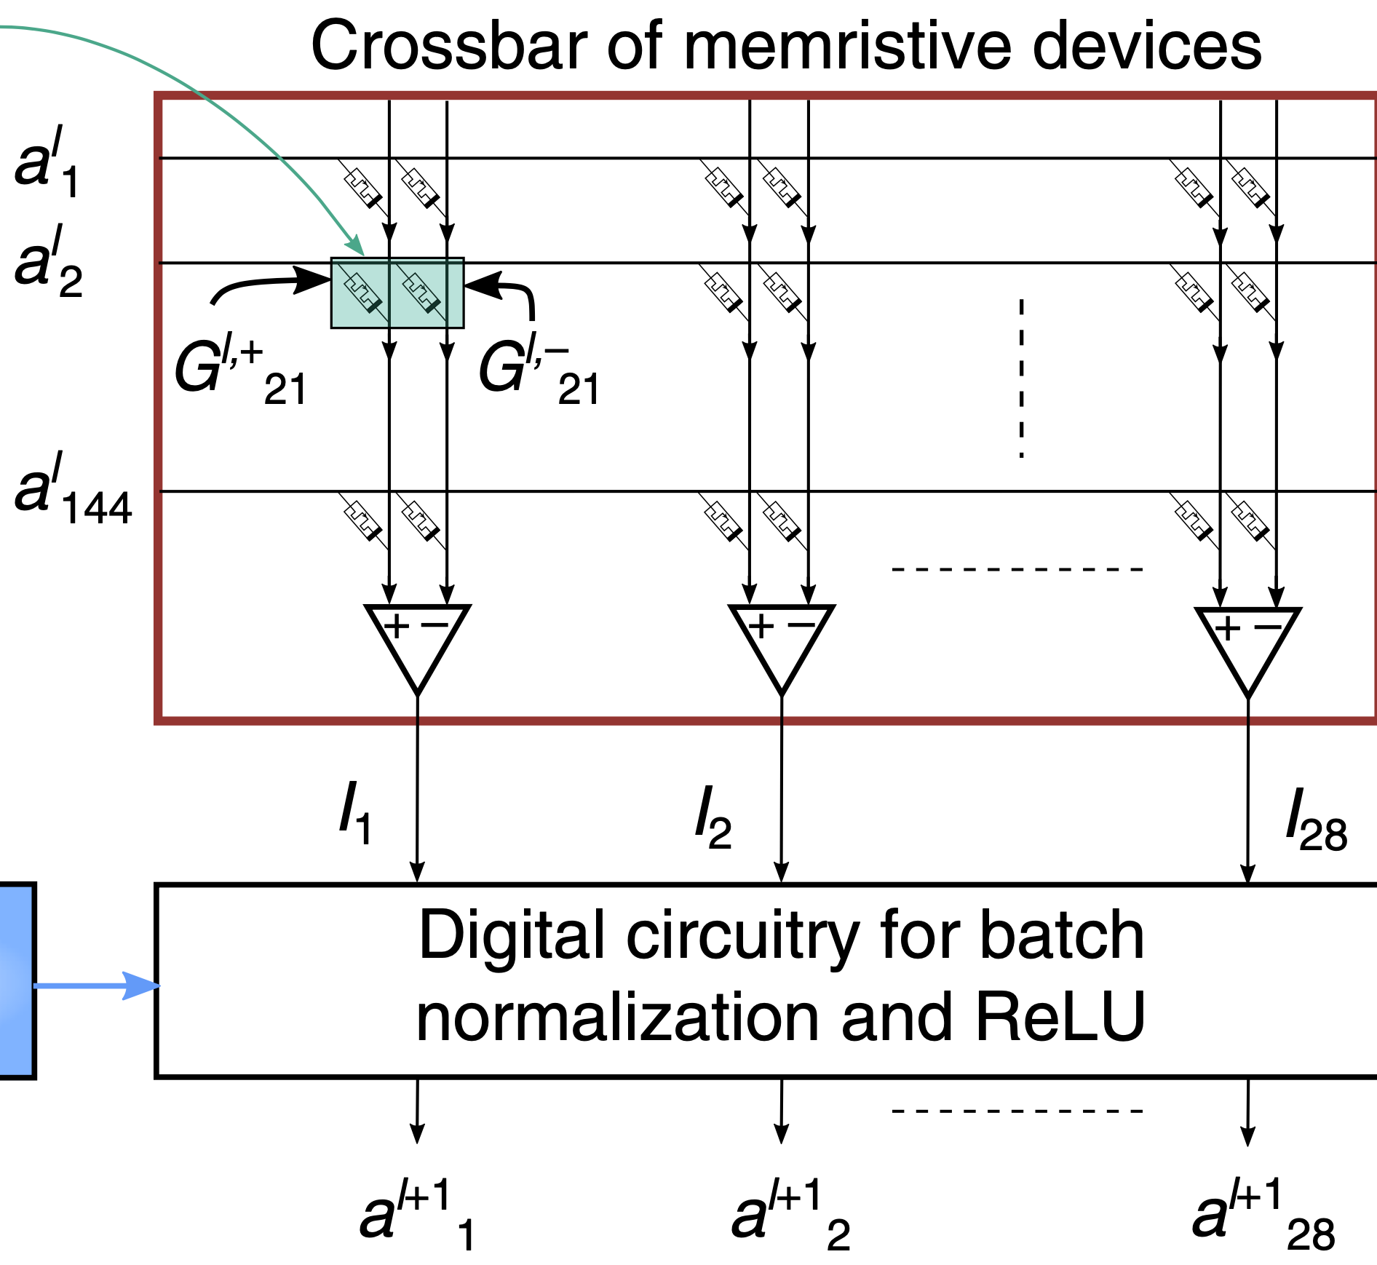
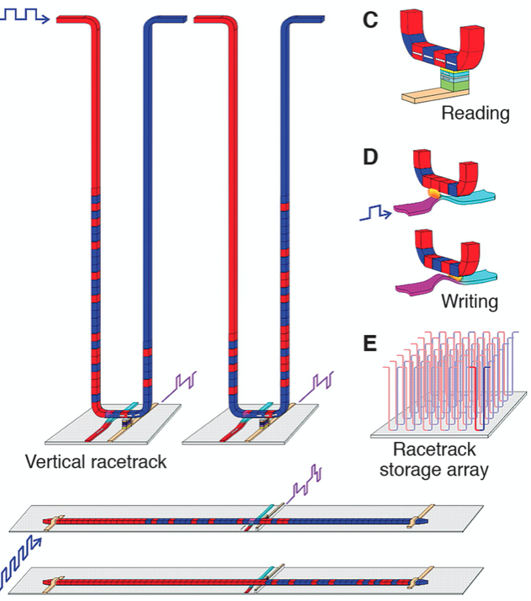
Emerging systems: Examples
High-bandwidth
memory
AI accelerators +
Prog. logic
Source: UPMEM
Source: AMD, AnandTech
Source: Samsung
Near-memory computing
Source: AMD
Emerging memories + in-memory computing
Source: IBM

Slide 4
Emerging systems: Examples
High-bandwidth
memory
AI accelerators +
Prog. logic
Source: UPMEM
Source: AMD, AnandTech
Source: Samsung
Near-memory computing
Extreme heterogeneity, non Von Neumann paradigms, custom number representations, custom data mapping, complex APIs, …
Source: AMD
Emerging memories + in-memory computing
Source: IBM

Slide 5
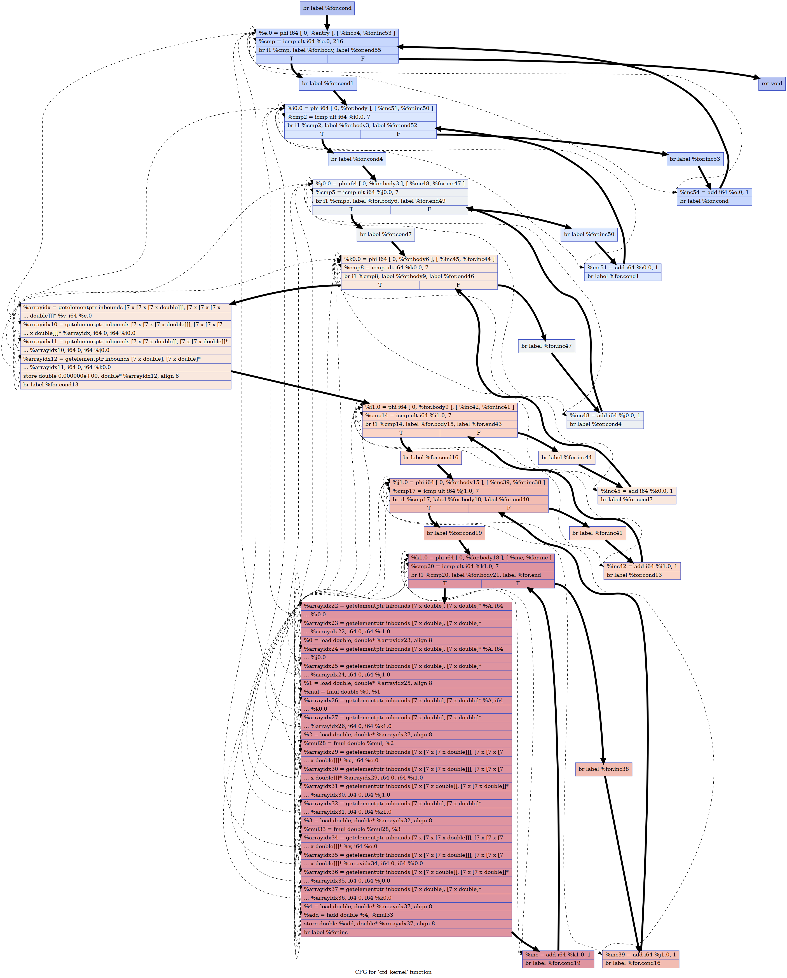
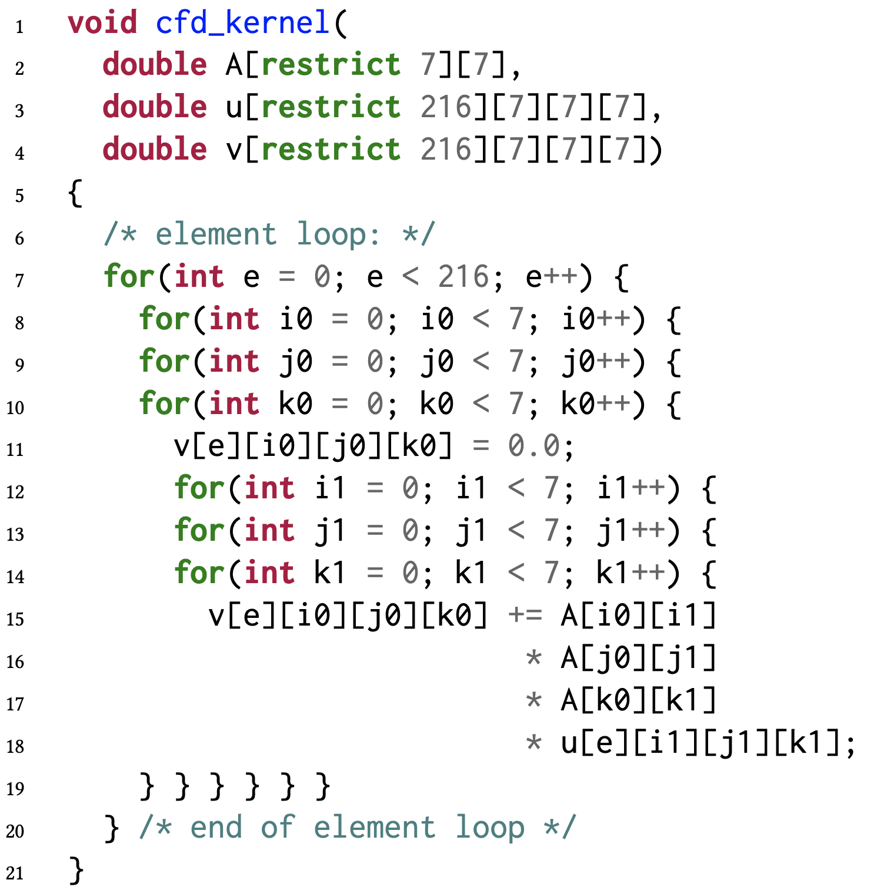
Abstractions and compilation
What we want
What we (naively) code
What compilers see
Notes:
Graph is a real compiler graph, already simplified:
source to use size_t and ran a shortened simplification pipeline so that integer promotions and pointer bouncing is at a minimum, and now its bearable.
I then hacked a small script that would post-process the LLVM graph, which turns every instruction into a node. Finally, I recovered the use-def relation and added all those arrows using that script.

Slide 6
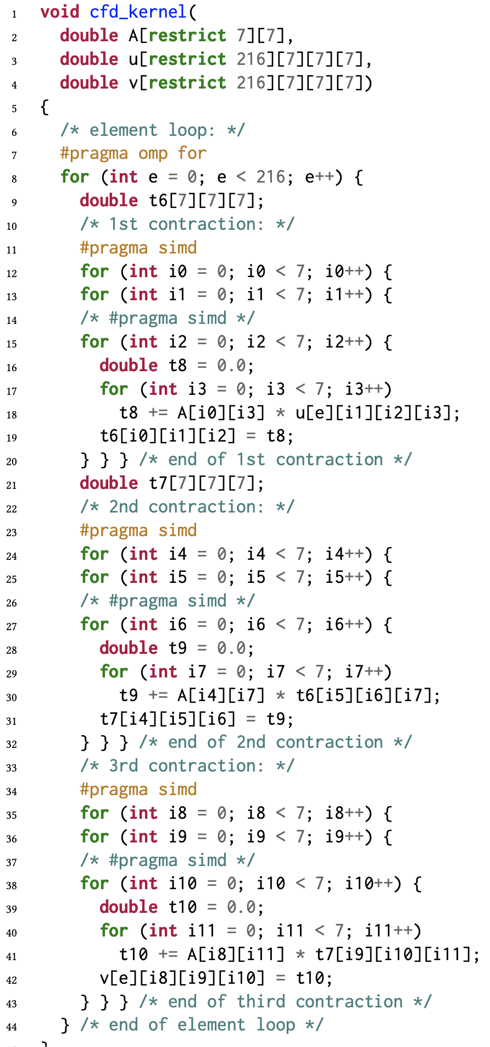
Abstractions and compilation
100X
What we want
What we (naively) code
What performance experts code
Notes:
Acknowledge work on recognizing patterns: Also very good! (but hard, and sometimes avoidable)

Slide 7
Abstractions and compilation
100X
What we want
???
???
???
AI accelerator
HBM+FPGA
Near-memory computing
Notes:
If we cannot make sense of this for normal Von Neumann machines. How can we leverage accelerators?

Slide 8
Abstractions and compilation
100X
What we want
???
???
???
Need for higher-level programming abstractions and next-gen compilers as well as novel computational and costs models for emerging accelerators
AI accelerator
HBM+FPGA
Near-memory computing
Notes:
If we cannot make sense of this for normal Von Neumann machines. How can we leverage accelerators?

Slide 9
The power of abstractions

Slide 10

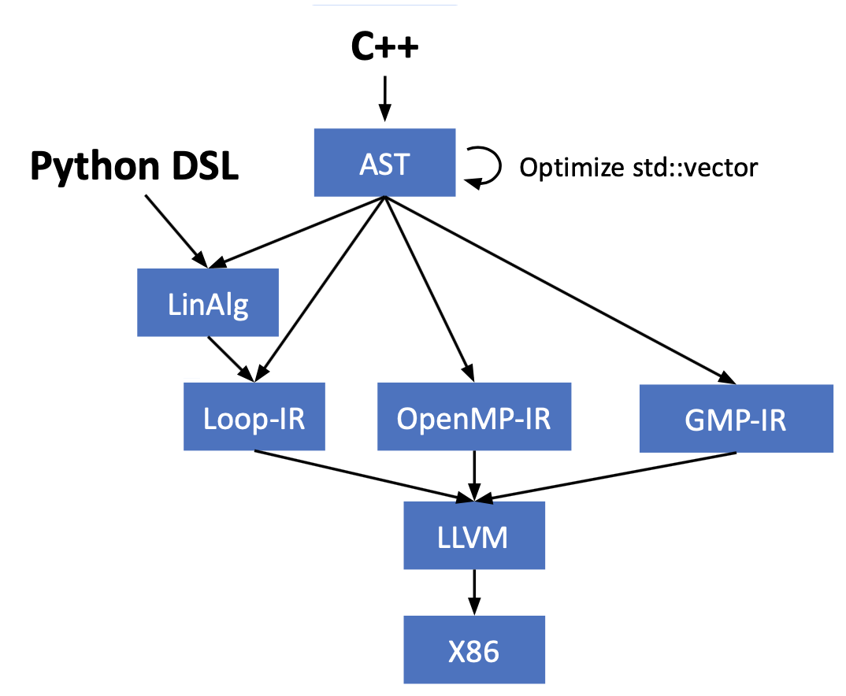
MLIR: Vehicle to capture abstractions
Started by Google ~2018, now in public domain
Not an IR, but an extensible framework
to describe intermediate abstractions
(called dialects),
to optimize representations between dialects
(transform, lower or raise),
that builds on the success of LLVM to build
community/infrastructure and reuse
Lattner, Chris, et al. "Mlir: Scaling compiler infrastructure for domain specific computation." 2021 IEEE/ACM International Symposium on Code Generation and Optimization (CGO). IEEE, 2021.
Source: T. Grosser, Univ. Edinburgh

Slide 11
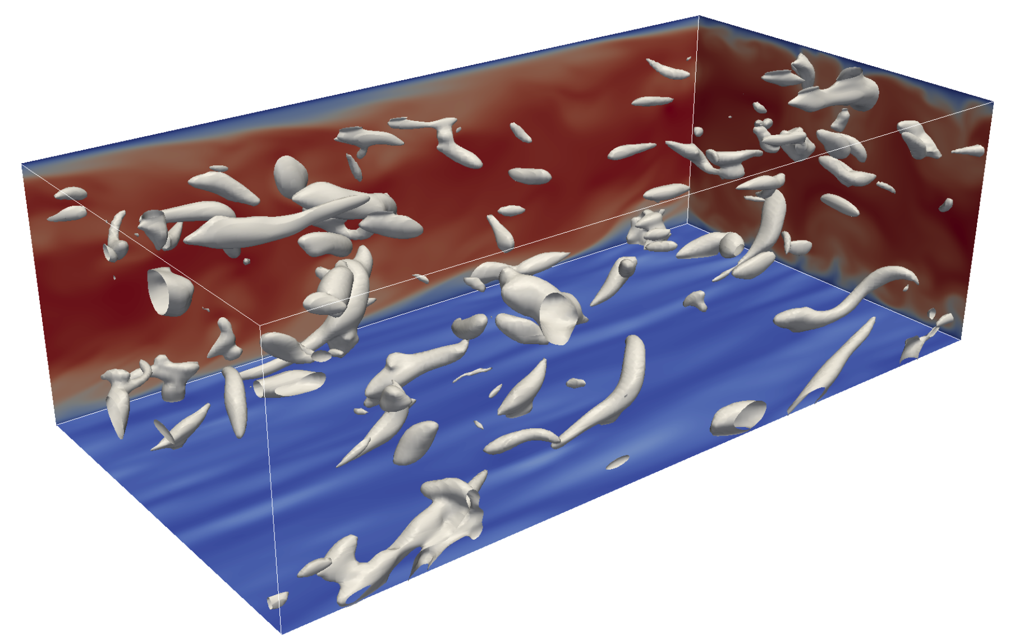
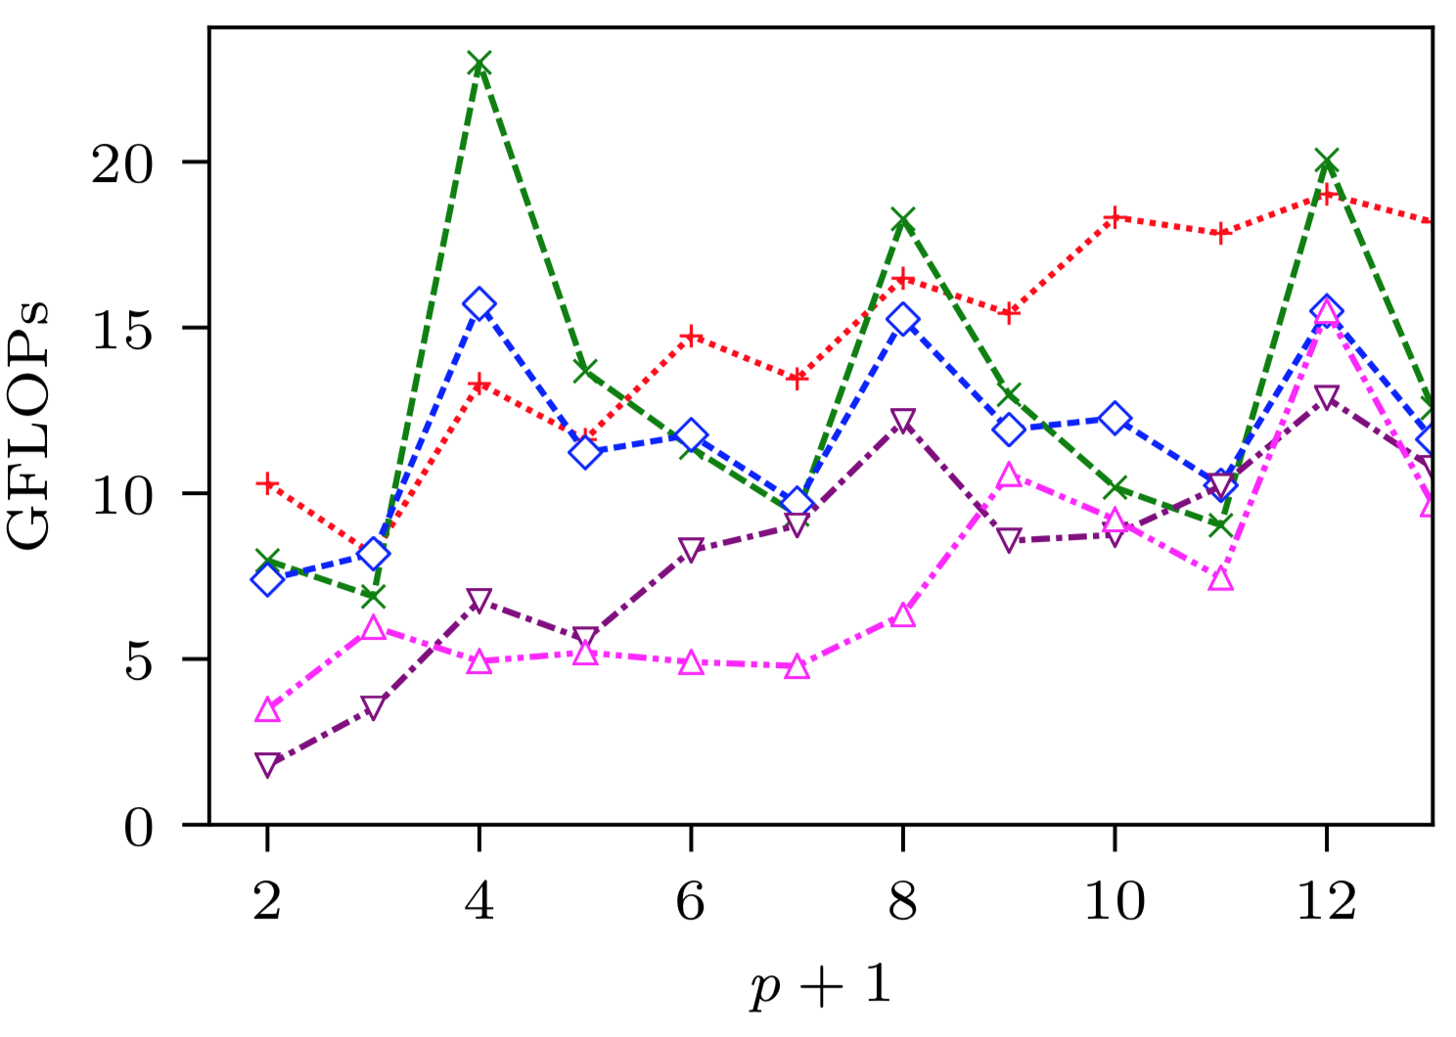
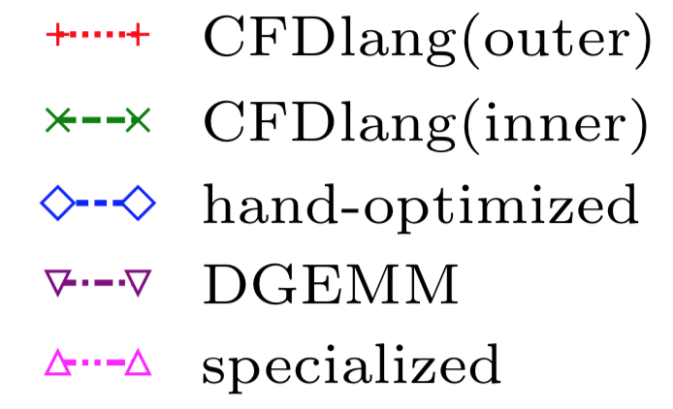
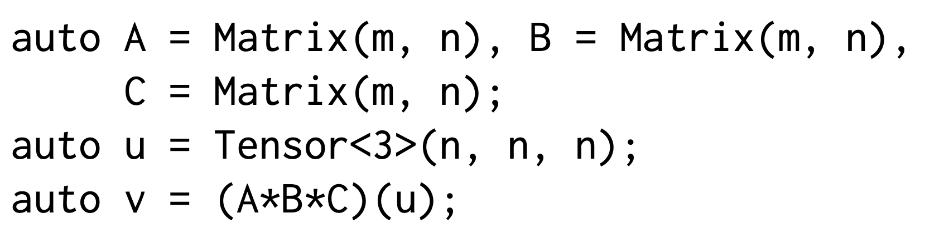
Example: Tensor expressions (Physics, ML)
CFDlang
Interpolation
source = ...
var input A : matrix &
var input u : tensorIN &
var input output v : tensorOUT &
var input alpha : [] &
var input beta : [] &
v = alpha * (A # A # A # u .
[[5 8] [3 7] [1 6]]) + beta * v
N. A. Rink, et al. “CFDlang: High-level code generation for high-order methods in fluid dynamics”. RWDSL’18.
N.A. Rink, N. A. and J. Castrillon. “TeIL: a type-safe imperative Tensor Intermediate Language”, ARRAY’19, pp. 57-68

Slide 12
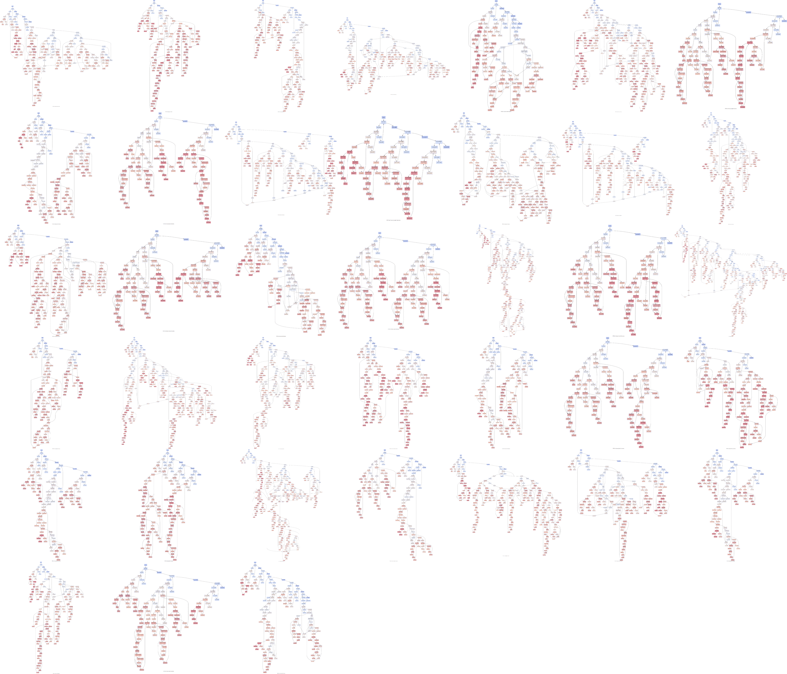
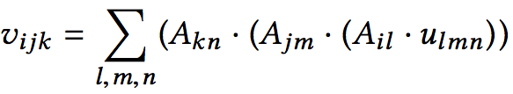
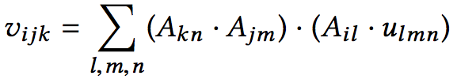
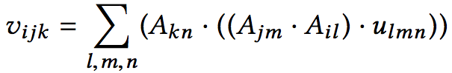
Closing the performance gap
Not really optimization magic
Leverage expert knowledge
Algebraic identities
Easy to generate, hard to transform
N. A. Rink, et al. “CFDlang: High-level code generation for high-order methods in fluid dynamics”. RWDSL’18.
A. Susungi, et al., "Meta-programming for Cross-Domain Tensor Optimizations", GPCE’18 pp. 79-92.
Actual code variants
Notes:
Interpolation (code in slide before)
Other operators, not mentioned here.
Plot: Interpolation operator, single thread performance, ne = 63 = 216 elements. Max GFLOP 40
The horizontal axes denote p + 1 (rather than p) since for polynomial order p, tensor dimensions take the value p + 1
CFDlang-generated code with the innermost placement of SIMD pragmas, i.e. CFDlang(inner)
The CFDlang-generated code with the outermost placement of SIMD pragmas, i.e. CFDlang(outer): worked better for other benchmark (Helmholtz) → Optimizing is needed

Slide 13

Tensor intermediate language (TeIL) in MLIR
Primitive ops instead of index maps
Easier to express identities (big-O trfs)
Uses symbolic math, infinite precision
Specialization path
to custom hardware
N.A. Rink, N. A. and J. Castrillon. “TeIL: a type-safe imperative Tensor Intermediate Language”, ARRAY’19, pp. 57-68
ub
K. F. A. Friebel, J. Bi, J. Castrillon, "BASE2: An IR for Binary Numeral Types" In ACM HEART 2023
bit
base2
llvm
arith
cyclic
index
No contracts
Weak contracts
Strong contracts
Notes:
Base2: Mentioned discussed in MLIR meeting in May 2023 → contrib. to the discussion around the arith dialect
From Karl, with index maps on non-value based tensors: from an arbitrary composition of maps in a non-value based abstraction, how are you supposed to figure out what the sequence of primitive index transforms was? This is needed to map structural properties of your inputs to your outputs.
TACO from MIT focuses on sparse. Our project is related to COMET 2021 (https://arxiv.org/pdf/2102.05187.pdf), kind of an implementation of the dense branch.
Classify to: Kind of identified patterns in linalg to raise th elevel of abstraction
TOSA is an ISA. It's a hardware and software spec. TOSA defines a small, fixed set of operations with exact semantics and datatypes. Also, it does not permit rescheduling, unless you can prove an accuracy bound. So, here TOSA could be an input (but that doesn't make sense, we want to do stuff TOSA does not permit). Slightly more relevant, TOSA could be an output for a HW that implements it. In that case, we'd do something like the GEMM example and map to the very constrained TOSA operators, i.e. extract a TOSA description from something we have in TeIL.
TCP will have a canonical linalg back-end. That would now imply none of these things are allowed. In that scenario, TeIL may be interesting as an alternate lowering path where we can do more aggressive changes. Current in the wild use cases for such abstractions are fancier "register allocation", i.e., bufferization that actually works. We can argue TeIL can help with that (see our Mnemosyne-using paper).

Slide 14
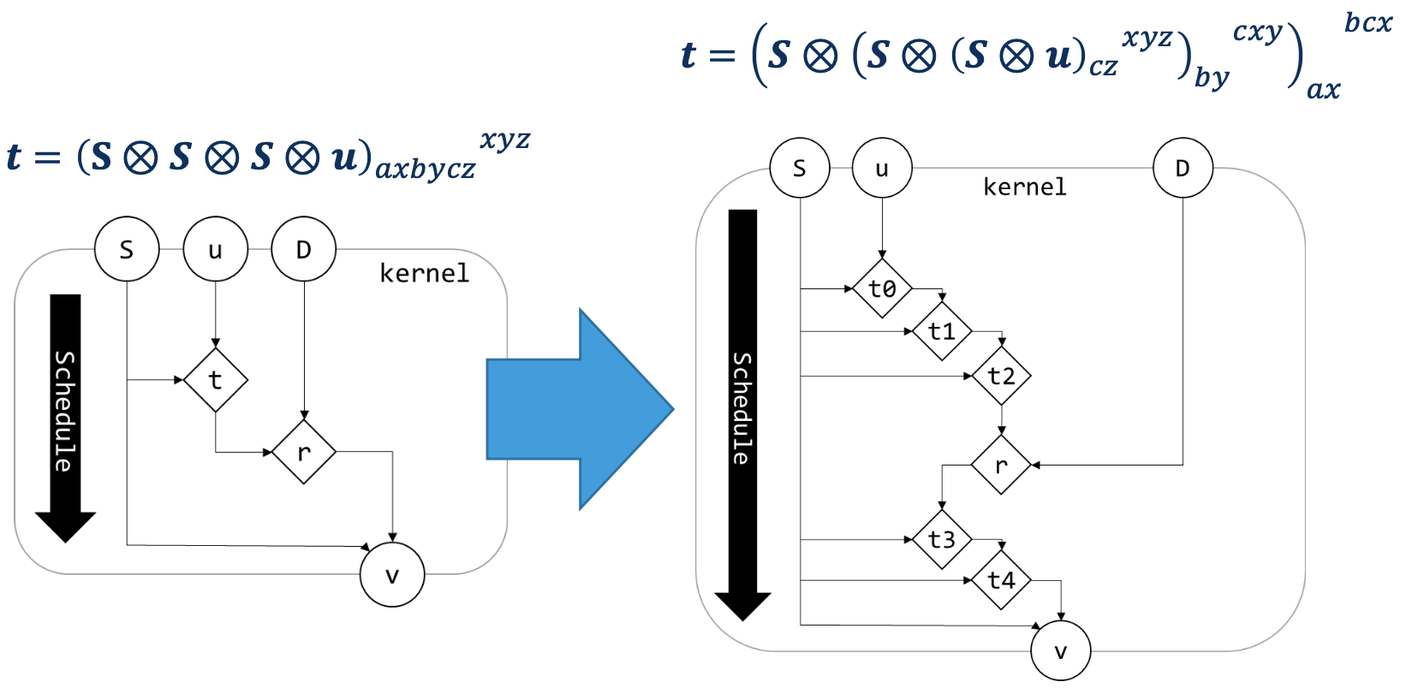
Domain-specific optimization
Encode algebraic transformations
Direct feedback to expert via DSL export

Slide 15

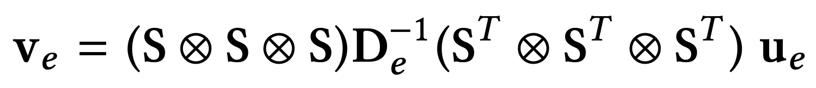
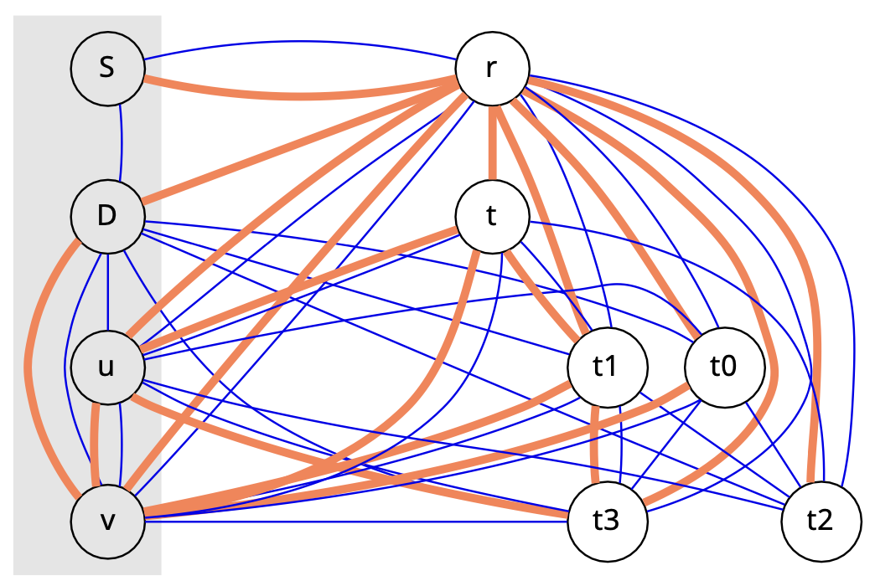
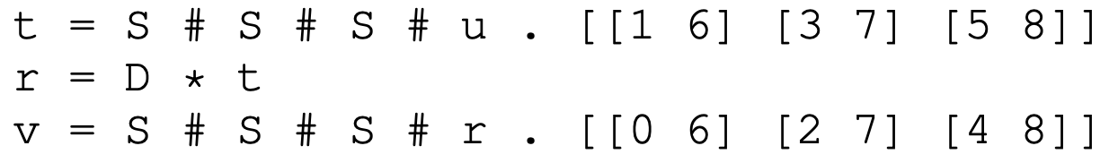
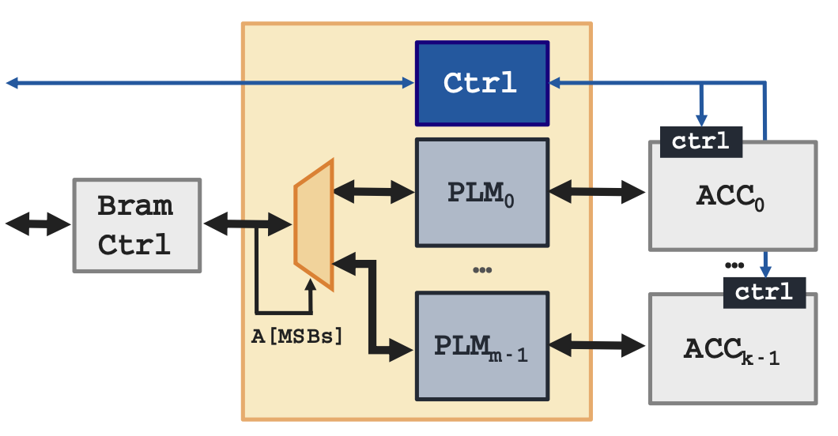
FPGA code generation: Bus-attached FPGAs
H2020 EU Project: Convergence HPC, Big Data and ML
Inverse Helmholtz Kernel
C. Pilato, et al. "EVEREST: A design environment for extreme-scale big data analytics on heterogeneous platforms”, DATE 2021
https://everest-h2020.eu
Lifetime analysis (polyhedral analysis)
Menosyne
mem-subsystem gen (buffer sharing)
K. F. A. Friebel, S. Soldavini, G. Hempel, C. Pilato, J. Castrillon, "From Domain-Specific Languages to Memory-Optimized Accelerators for Fluid Dynamics", Proceedings of the FPGA for HPC Workshop, held in conjunction with IEEE Cluster 2021, Sep 2021

Slide 16
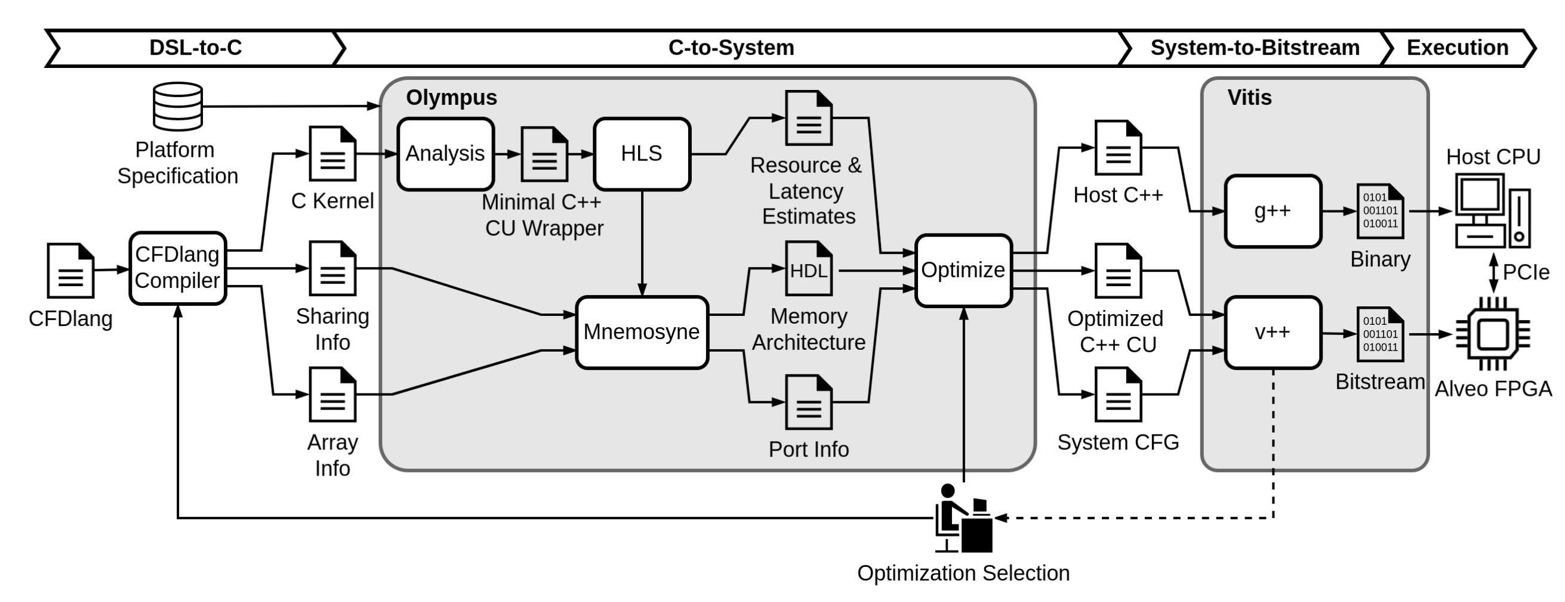
Putting it all together
Complex compilation/design flow from DSL to system-level architecture
HBM+FPGA
S. Soldavini, K. F. A. Friebel, M. Tibaldi, G. Hempel, J. Castrillon, and C. Pilato. “Automatic Creation of High-Bandwidth Memory Architectures from Domain-Specific Languages: The Case of Computational Fluid Dynamics”. In: ACM TRETS, Sept. 2022.
Notes:
Mention complexity of HBM system

Slide 17
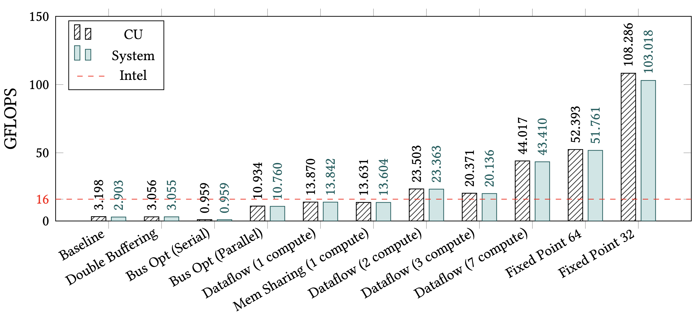
FPGA code generation: HBM FPGA
H2020 EU Project: Convergence HPC, Big Data and ML
Transformations for a 17x speedup (same precision)
https://everest-h2020.eu
HBM+FPGA
S. Soldavini, K. F. A. Friebel, M. Tibaldi, G. Hempel, J. Castrillon, and C. Pilato. “Automatic Creation of High-Bandwidth Memory Architectures from Domain-Specific Languages: The Case of Computational Fluid Dynamics”. In: ACM TRETS, Sept. 2022.
Notes:
ALVEO U280
Results quite impressive for a single CU (first plot), polynomial degree of 11 (the highest)
Lots of optimizations, not all automated…
Mention that baseline: Mismatch of VN abstraction with dataflow

Slide 18
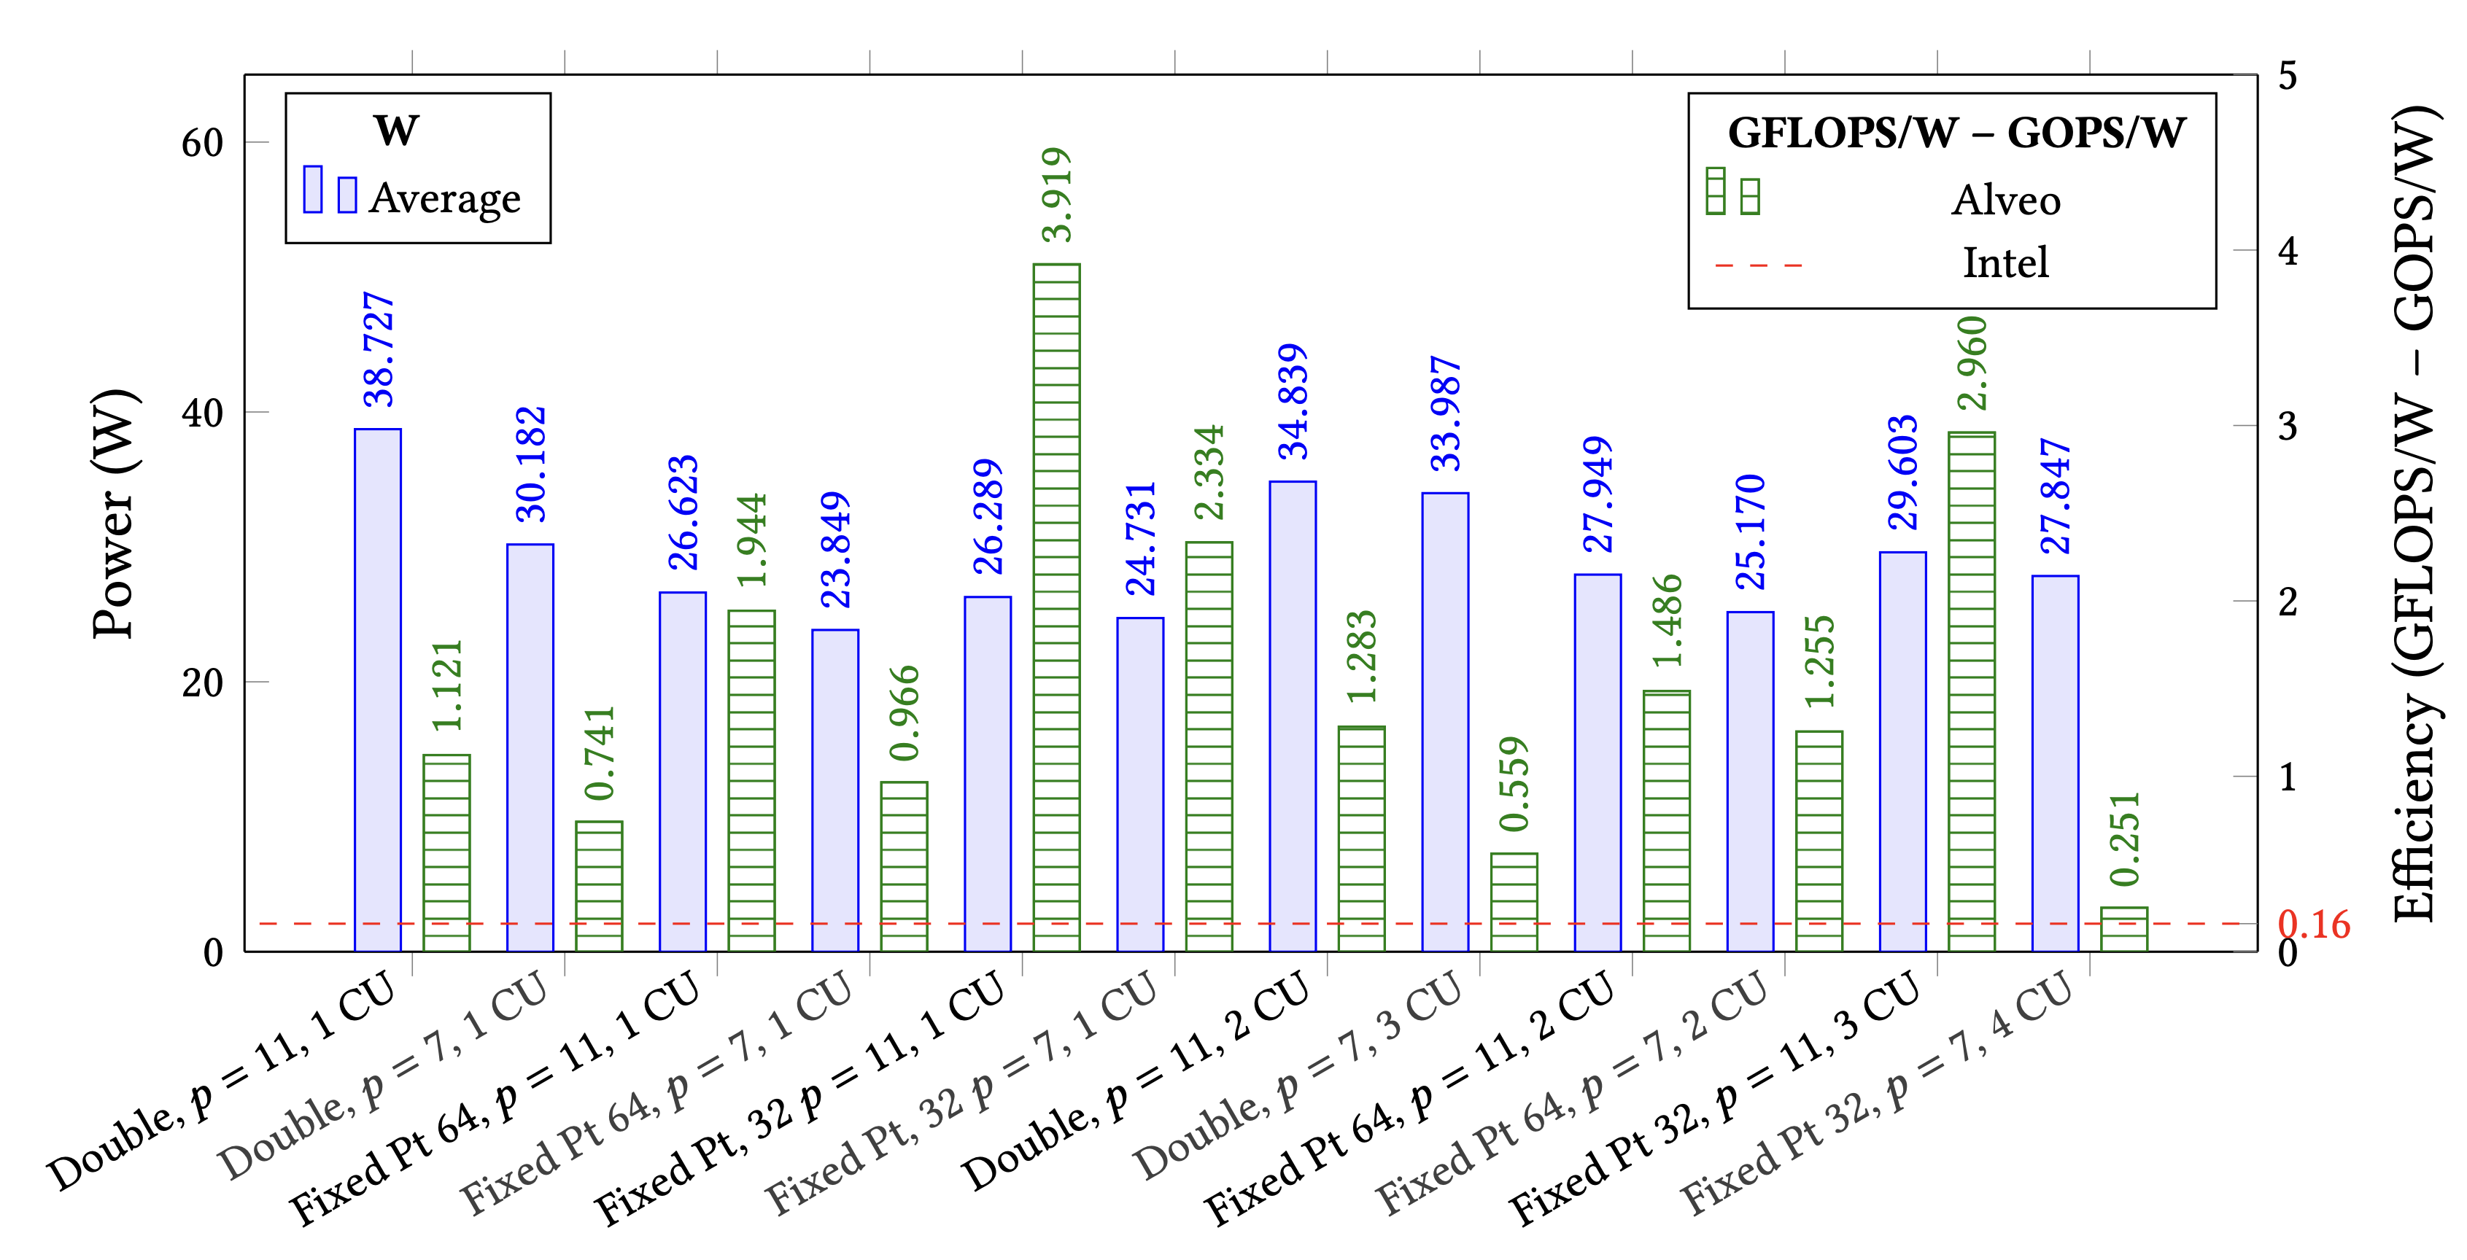
FPGA code generation: HBM FPGA
H2020 EU Project: Convergence HPC, Big Data and ML
Variants with up to 24x better energy efficiency
https://everest-h2020.eu
S. Soldavini, K. F. A. Friebel, M. Tibaldi, G. Hempel, J. Castrillon, and C. Pilato. “Automatic Creation of High-Bandwidth Memory Architectures from Domain-Specific Languages: The Case of Computational Fluid Dynamics”. In: ACM TRETS, Sept. 2022.
Notes:
Results quite impressive for a single CU, polynomial degree of 11 (the highest)
The efficiency plot has a lot of different configurations, with different polynomial degrees, different number of Cus
Some more details
Assuming 100 W for Intel, with best implementation in a signle thread of 16 GFLOPs.
More CUs led to higher overhead in logic, reducing frequency. So not as good as we thought.
Highest throughput of 172 GOPS (1 CU, fixed-point) led to only 87 GOPS in the system, results are serialized for the host.

Slide 19
Base2: Custom precision analysis
Interpolation
float
float
fix
Fix
K. F. A. Friebel, J. Bi, J. Castrillon, "BASE2: An IR for Binary Numeral Types", In ACM HEART 2023
Significand precision 𝑝
(exp_bits = 6)
Exponent range ld 𝐸 (frac_bits = 32)
Notes:
- Talk about softfloat: SW emulation → FGPA exec.
- First four plots: In theory, we would expect a diagonal boundary where frac_bits = 𝑝. Because the kernel is heavy on multiplications, the error is dominated by a rightward gradient.

Slide 20
Inference: Reconfigurable HW & emerging memories

Slide 21
Adaptable inference
High-level operator graphs + quantized data types (Brevitas, FINN)
Trade-off: Pruning, early exit and confidence threshold
CONV, 128 Ch.
CONV, 64 Ch.
Max Pooling
Max Pooling
CONV, 128 Ch.
CONV, 256 Ch.
FC, 512 Neur.
FC, 512 Neur.
CONV, 64 Ch.
CONV, 256 Ch.
FC, 10 Neur.
CONV, 64 Ch.
CONV, 128 Ch.
Max Pooling
Max Pooling
G. Korol, M. G. Jordan, M. B. Rutzig, J. Castrillon, A. C. Schneider Beck, "Pruning and Early-Exit Co-Optimization for CNN Acceleration on FPGAs", DATE 2023
FC, 512 Neur.
FC, 512 Neur.
FC, 10 Neur.
FC, 10 Neur.

Slide 22
Adaptable inference: Results
Trade-off space @ design time for CNVW2A2 on CIFAR10
Combined effect of jointly adapting pruning and early exits
G. Korol, M. G. Jordan, M. B. Rutzig, J. Castrillon, A. C. Schneider Beck, "Pruning and Early-Exit Co-Optimization for CNN Acceleration on FPGAs", DATE 2023
Notes:
Plots accuracy vs Inferences Per Second (or IPS) and versus Energy/Inference. The size of each point here is given by the pruning rate and the color gives you the confidence threshold. You can also notice that we differentiate whether the exits were also pruned or not by squares or circles.
Now, Let us focus on the cifar dataset as an example. First thing to notice is that, as expected, the smaller models (represented by smaller points) run faster granting a higher throuput. The same is observed on the energy efficieency plot. Both savings in processing time and energy come with costs in accuracy, and that‘s why we see the smallest points with the lowest accuracy levels.
There is also another intersting behavior in the energy efficiency plot that shows us that from the most consuming settings up to around 4uJ there is no major accuracy loss as we prune or lower the confidence of the CNN. Beyound that, losses in accuracy get more evident.
First, let‘s see the Energy-Delay Product w.r.t FINN for AdaPex and the PR and CT-Only baselines under cifar and gtsrb datasets. Here, it is clear how AdaPex can combine gains from both techniques.
It also relvant to us to see how those performance gains do in respect to accuracy. For that, we have the Quality of Experience here on the curves an right y-axis. Quality experience is the product between the average accuracy over the evalaution and the rate of processed inferences. And again, we see that adding the capability to exit early to pruned CNNs resulted in the best compromise between performance and accuracy.

Slide 23
Offloading to the edge
Balance local and edge compute: Accuracy, throughput, energy
Edge: Higher confidence, more parallelism, communication overhead
Device: Local compute, resource constrained
Metrics vary with scenario: Video decoding stable (walking) or instable (tram)
Stable
Instable
G. Korol, M. G. Jordan, M. B. Rutzig, J. Castrillon, A. C. Schneider Beck, “"Design Space Exploration for CNN Offloading to FPGAs at the Edge", ISVLSI 2023

Slide 24
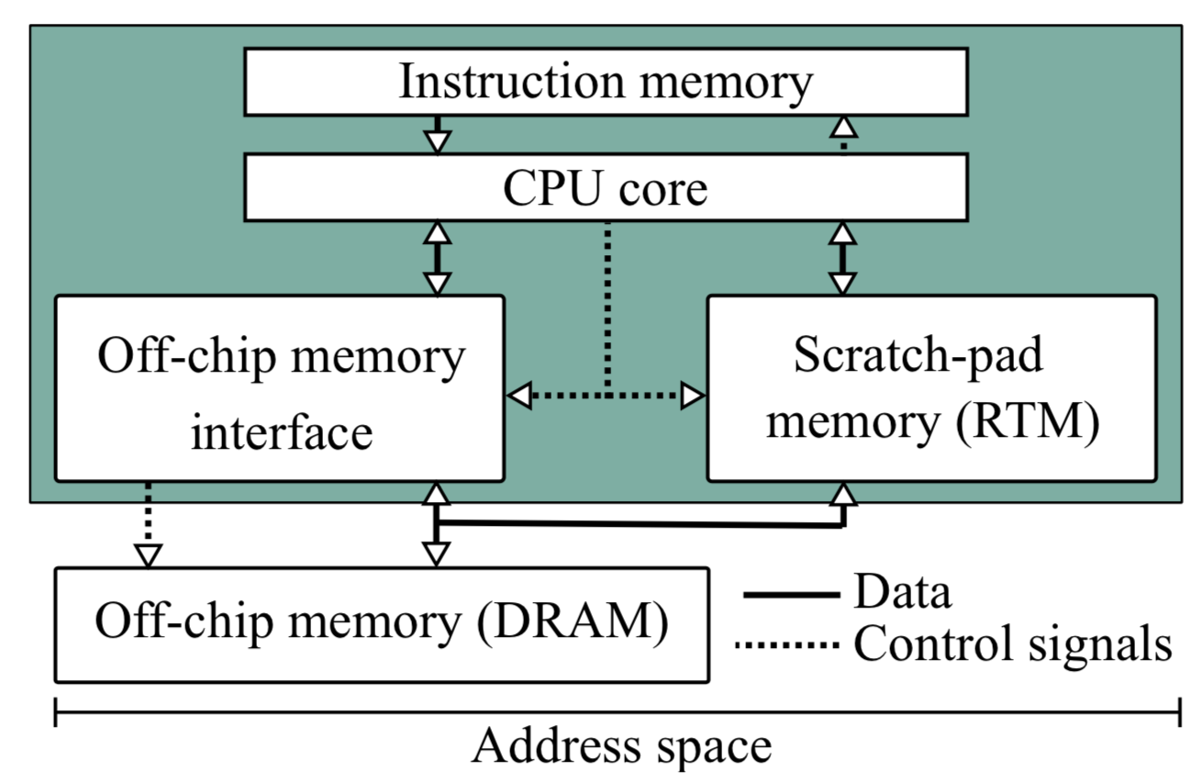
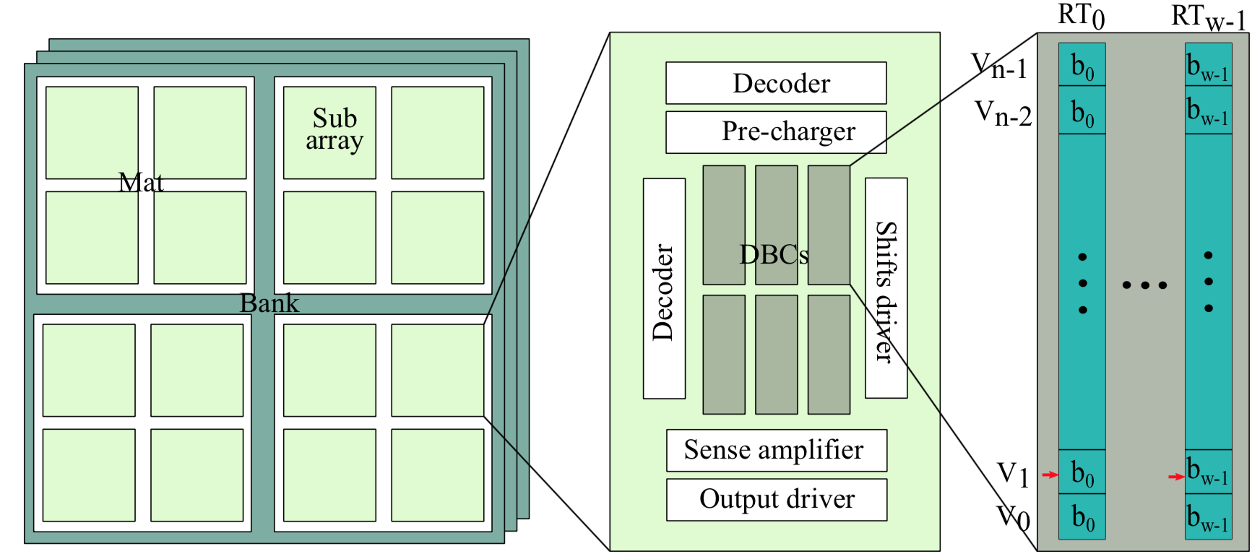
Higher abstractions and data layout
The case of racetrack memories (RTMs)
Density of DRAM & size/latency of SRAM!
Memory cell stores up to 100 bit sequentially (in tracks)
Latency highly depends on allocation and address traces
Khan, et al. "RTSim: A Cycle-accurate Simulator for Racetrack Memories", In IEEE Computer Architecture Letters, 2019
R. Bläsing, et al. "Magnetic Racetrack Memory: From Physics to the Cusp of Applications within a Decade", In Proceedings of the IEEE, vol. 108, no. 8, pp. 1303-1321, Mar 2020.

Slide 25
Tensor contractions on RTMs
Consecutive accesses can be pre-shifted
Zig-zagging: Avoid “rewinding the tape”

Slide 26
Latency comparison vs SRAM
Un-optimized and naïve mapping: Even worse latency than SRAM
24% faster (even with very conservative circuit simulation)
A. A. Khan, et al, "Optimizing Tensor Contractions for Embedded Devices with Racetrack Memory Scratch-Pads”, LCTES’19, pp. 5-18, 2019
A. A. Khan, et al. “Optimizing Tensor Contractions for Embedded Devices with Racetrack and DRAM Memories”. ACM TECS 2020

Slide 27
Energy comparison vs SRAM
Higher savings due to less leakage power
74% less energy (in addition to savings due to DRAM placement)
A. A. Khan, et al, "Optimizing Tensor Contractions for Embedded Devices with Racetrack Memory Scratch-Pads”, LCTES’19, pp. 5-18, 2019
A. A. Khan, et al. “Optimizing Tensor Contractions for Embedded Devices with Racetrack and DRAM Memories”. ACM TECS 2020
Notes:
- Important: At PASC’21 many people talking about the famous 3Ps: Performance, Portability and Productivity. One thing missing here is ENERGY (climate modeling → better ought to be efficient)

Slide 28
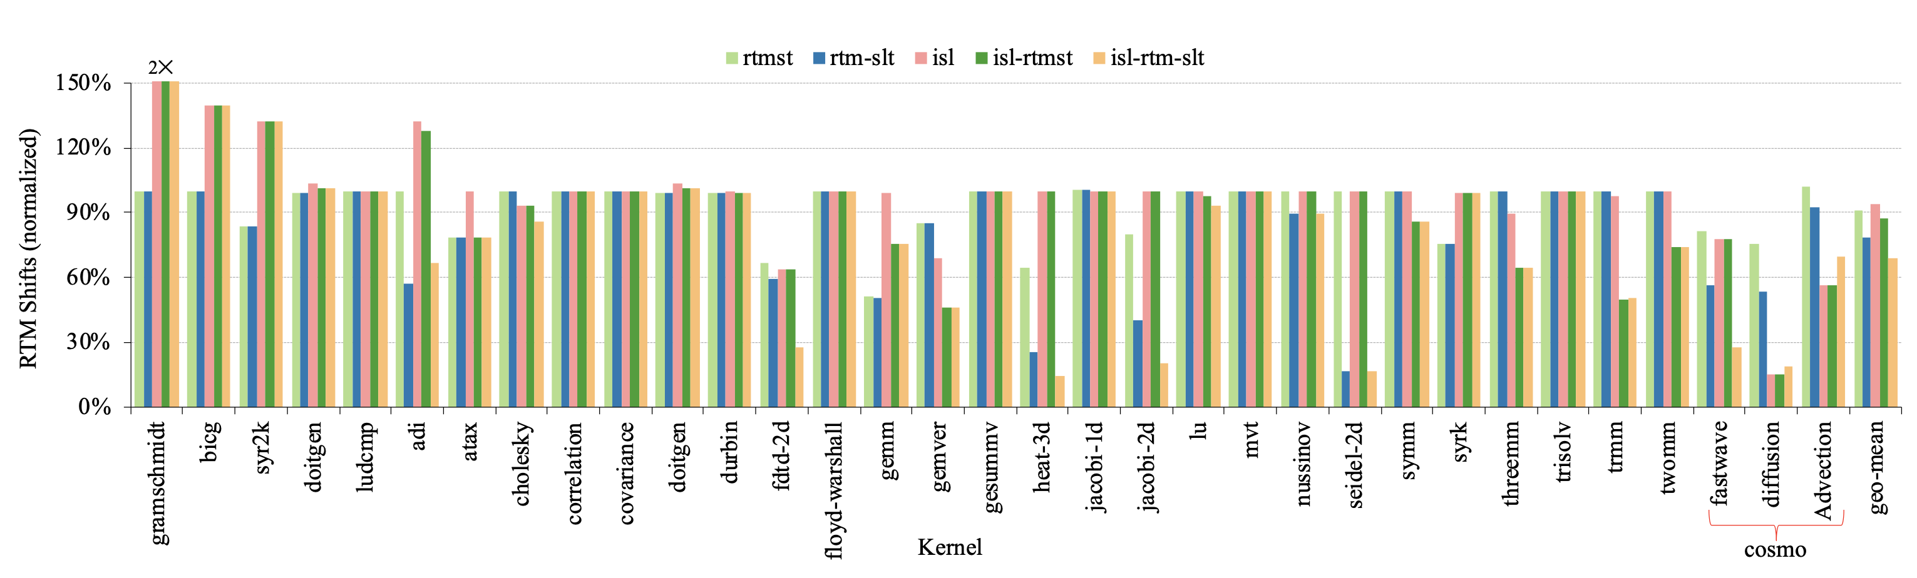
Generalization: Optimizations for RTM
Average improvements in performance (~20%) and energy consumption (~40%)
Khan, et al. "Polyhedral Compilation for Racetrack Memories”. IEEE TCAD 2020

Slide 29
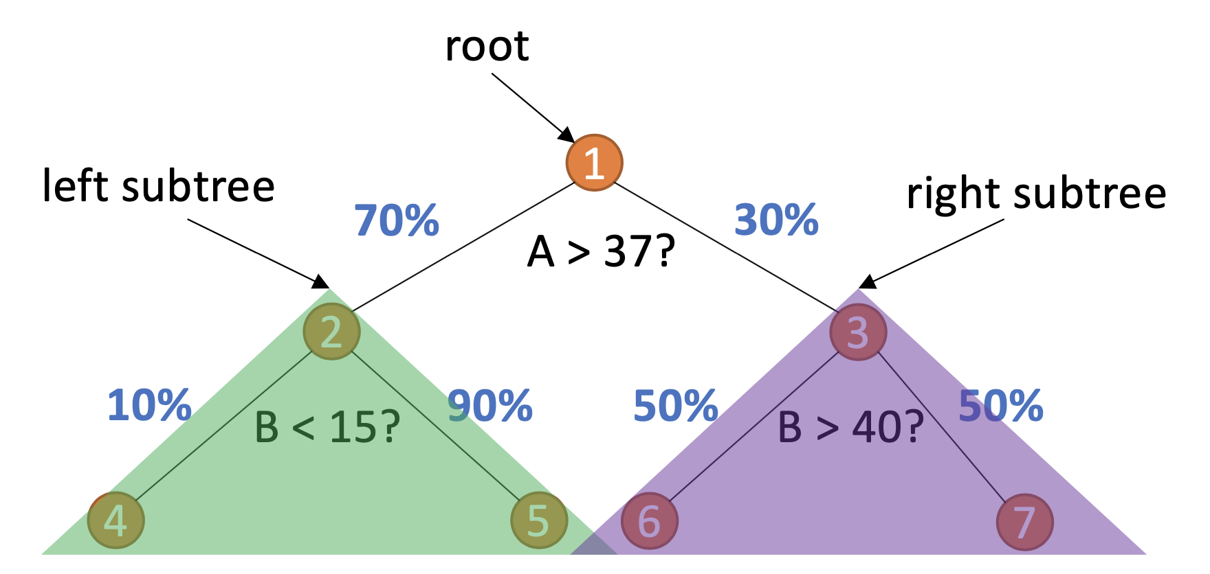
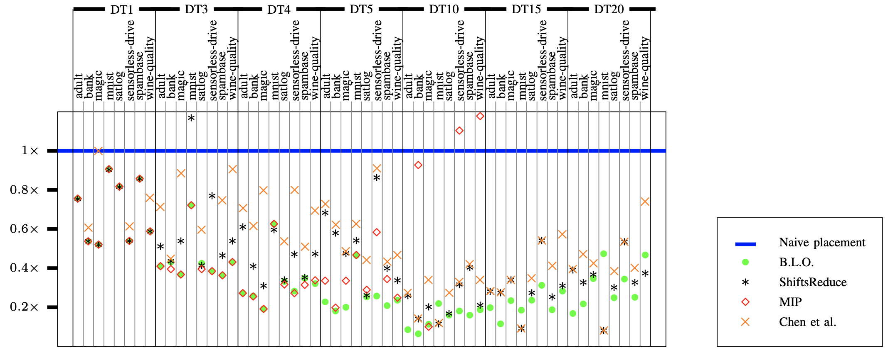
Random forests: Irregular access patterns
RFs Popular for decision making @ the edge
Use training statistics for tree placement
C. Hakert, “BLOwing Trees to the Ground: Layout Optimization of Decision Trees on Racetrack Memory”, DAC 2021
Notes:
Also another kind of ML
We adopt an open-source framework published in 2018 and select 8 typical machine learning classification datasets from the UCI Machine Learning Repositories
[13] Y. LeCun. The mnist database of handwritten digits. 1998.
[14] M. Lichman. UCI machine learning repository, 2013.

Slide 30
Near and in-memory computing

Slide 31
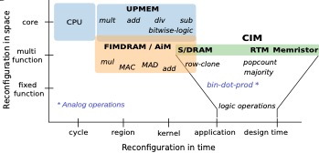
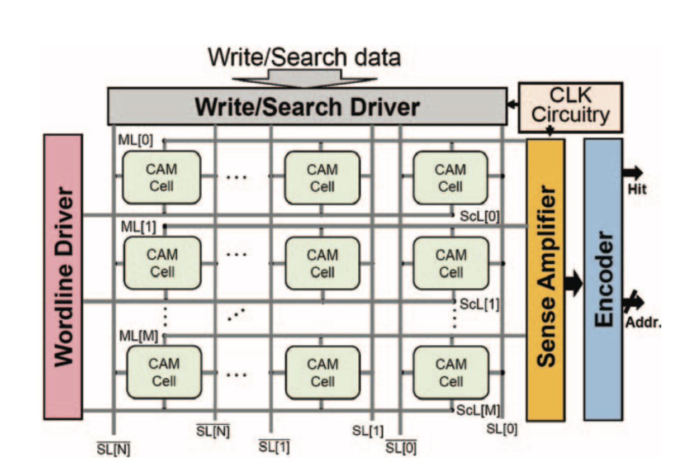
Rich landscape of designs
Near-memory: Processors, logic close to memory
In-memory (aka processing using memory): Leverage device properties
Samsung, Lee, Sukhan, et al. ISCA 2021
UPMEM by Gómez-Luna, Juan, et al. arXiv:2105.03814 (2021)
In-PCM Computing: Joshi, Vinay, et al. Nature Communications 11.1 (2020): 1-13.
CAM accelerators: Hu, Sharon, et al. 2021 IEDM

Slide 32
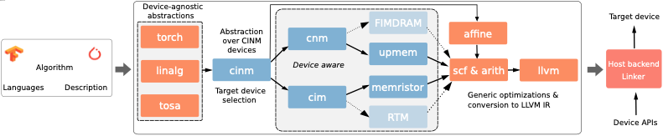
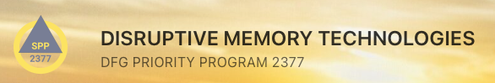
CINM: Generalized MLIR infrastructure
From linear algebra abstractions (common to ML frameworks and beyond)
Intermediate languages for in and near memory computing
Pattern recognition, target-specific models and optimizations
A. Khan et al, "CINM (Cinnamon): A Compilation Infrastructure for Heterogeneous Compute In-Memory and Compute Near-Memory Paradigms", arXiv, Aug 2023

Slide 33
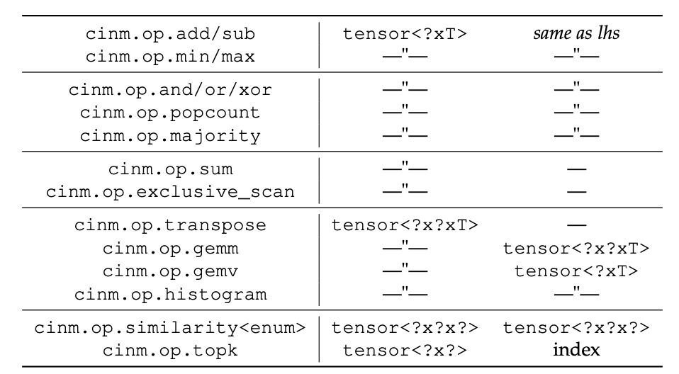
CINM: Generalized MLIR infrastructure
From linear algebra abstractions (common to ML frameworks and beyond)
Intermediate languages for in and near memory computing
Pattern recognition, target-specific models and optimizations
A. Khan et al, "CINM (Cinnamon): A Compilation Infrastructure for Heterogeneous Compute In-Memory and Compute Near-Memory Paradigms", arXiv, Aug 2023

Slide 34
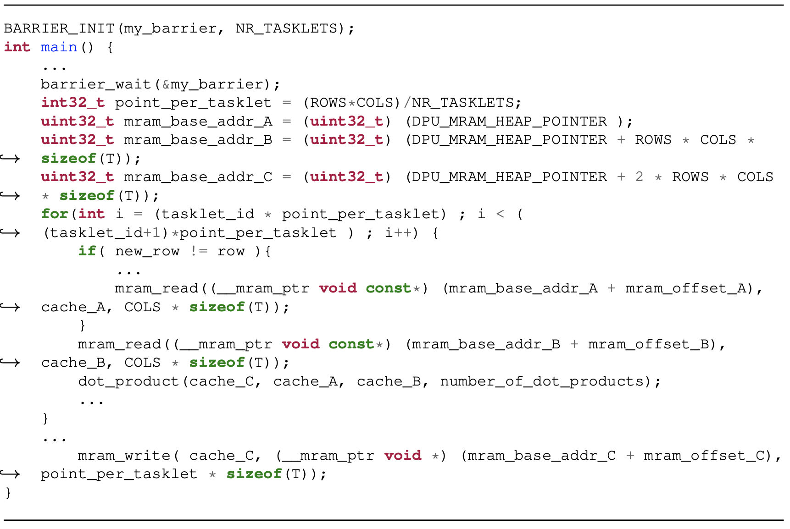
UPMEM example: Matmult
def mm(int32(64, 64) A, int32(64, 64) B) -> (int32(64, 64) C) {
C(i,j) += A(i,k) * B(k,j)
where i in 0:64, k in 0:64, j in 0:64
}
Notes:
Skipping some intermediate spaces. Last one is tiled for gather-scatter + explicit DMA

Slide 35
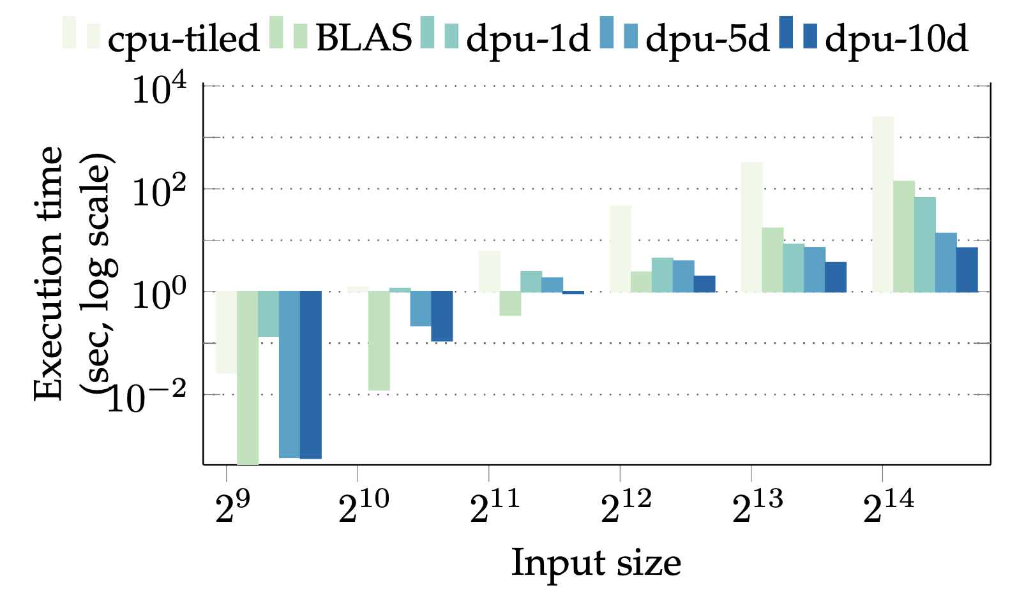
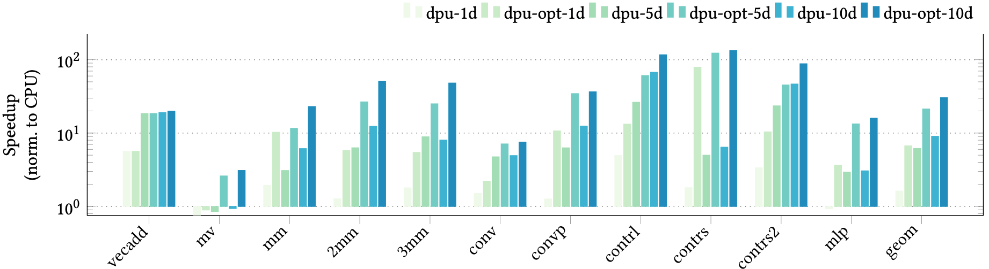
UPMEM example: Results
1-DIMM 128 DPUs
5-DIMMs 640 DPUs
10-DIMMs 1280-DPUs
6.1×, (1 DIMM) 21.3× (5 DIMM) and 30.4× (10 DIMM) wrt host CPU
Matmult
Notes:
On average (geometric mean) across all benchmarks, the dpu-1d, dpu-5d and dpu-10d configurations are 6.1×, 21.3× and 30.4× faster than the host CPU, respectively. For mv, all DPU unoptimized configurations are slower than the host CPU because there is no data reuse. vecadd also has no reuse but still gets speedup because the addition operation on the DPU is much faster compared to multiplication. As shown, the speedup for 3mm benchmark compared to 2mm is relatively small due to the data dependencies of the third GEMM operation on the first two GEMM operations in 3mm. The host puts the synchronization barrier after the first two multiplications in order to get both operands for the third multiplication before offloading it to the DPUs. The significant speedup in all kernels for the DPU configurations is entirely due to the higher number of compute units in the UPMEM systems compared to the CPU. For instance, the vecadd kernel consists of 10k vector additions, each having 212 dimensions. The baseline CPU only takes 0.982 sec (ab- solute numbers). Still, since the UPMEM systems have 128, 640 and 1280 DPUs and there are no data dependencies, it takes 0.17 sec, 0.053 sec and 0.049 sec (absolute) for them respectively to compute the kernel, resulting in a speedup of up to 20×. The dpu-10d configuration does not show much improvement comapred to the dpu-5d because the workload does not benifit from the additional DPUs. In benchmarks such as mlp and conv, where the host CPU preprocesses the kernel before offloading it, the speedup compared to the CPU is not as significant.

Slide 36
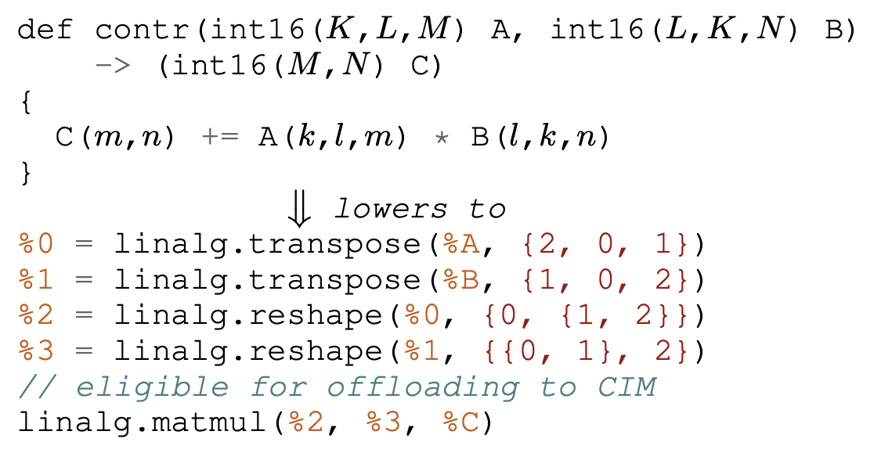
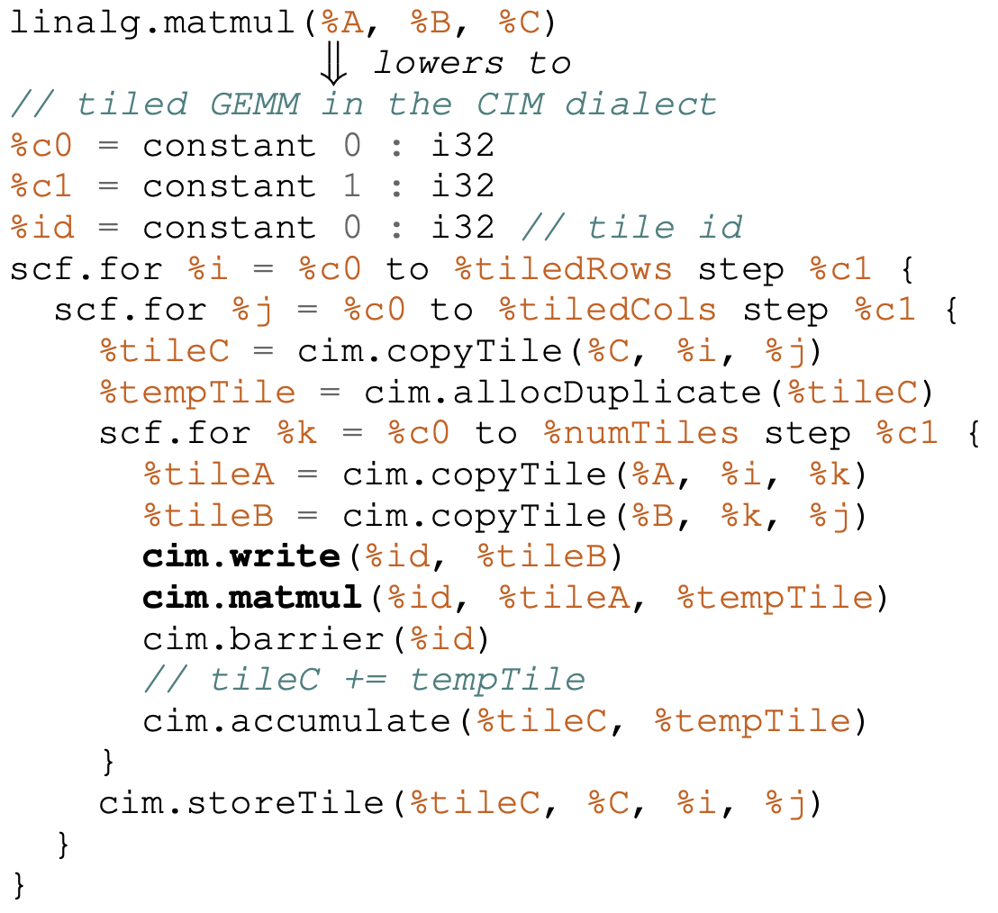
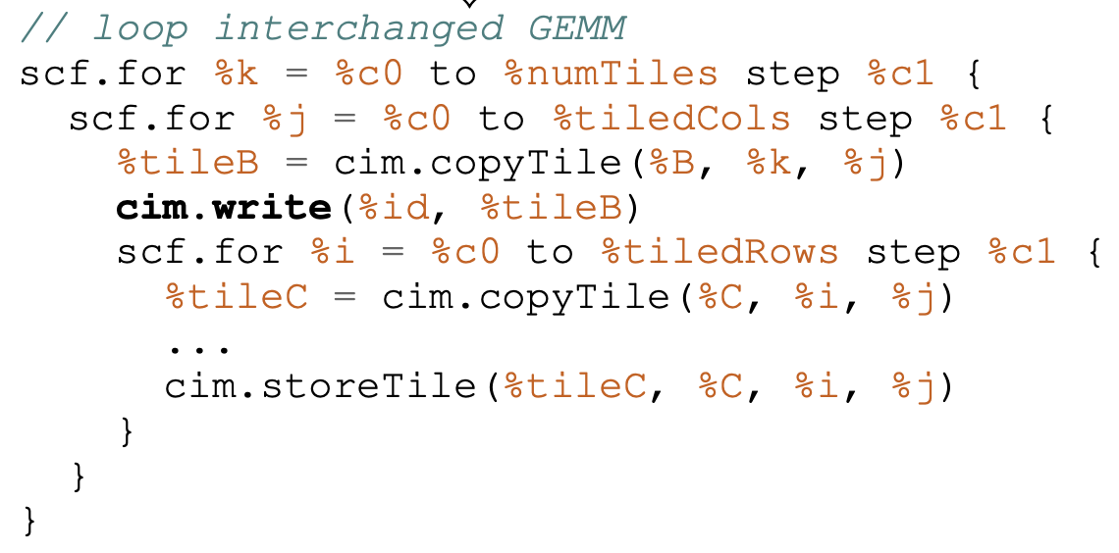
CIM: Lowering examples
Notes:
Again the Transpose Transpose GEMM Transpose (TTGT) rewriting rule, but here using linalg.matmul
Tiling: break down the operations to the size of the array. Creates buffers (alllocDuplicate)
Interchange: reduces the amount of writes → better for endurance

Slide 37
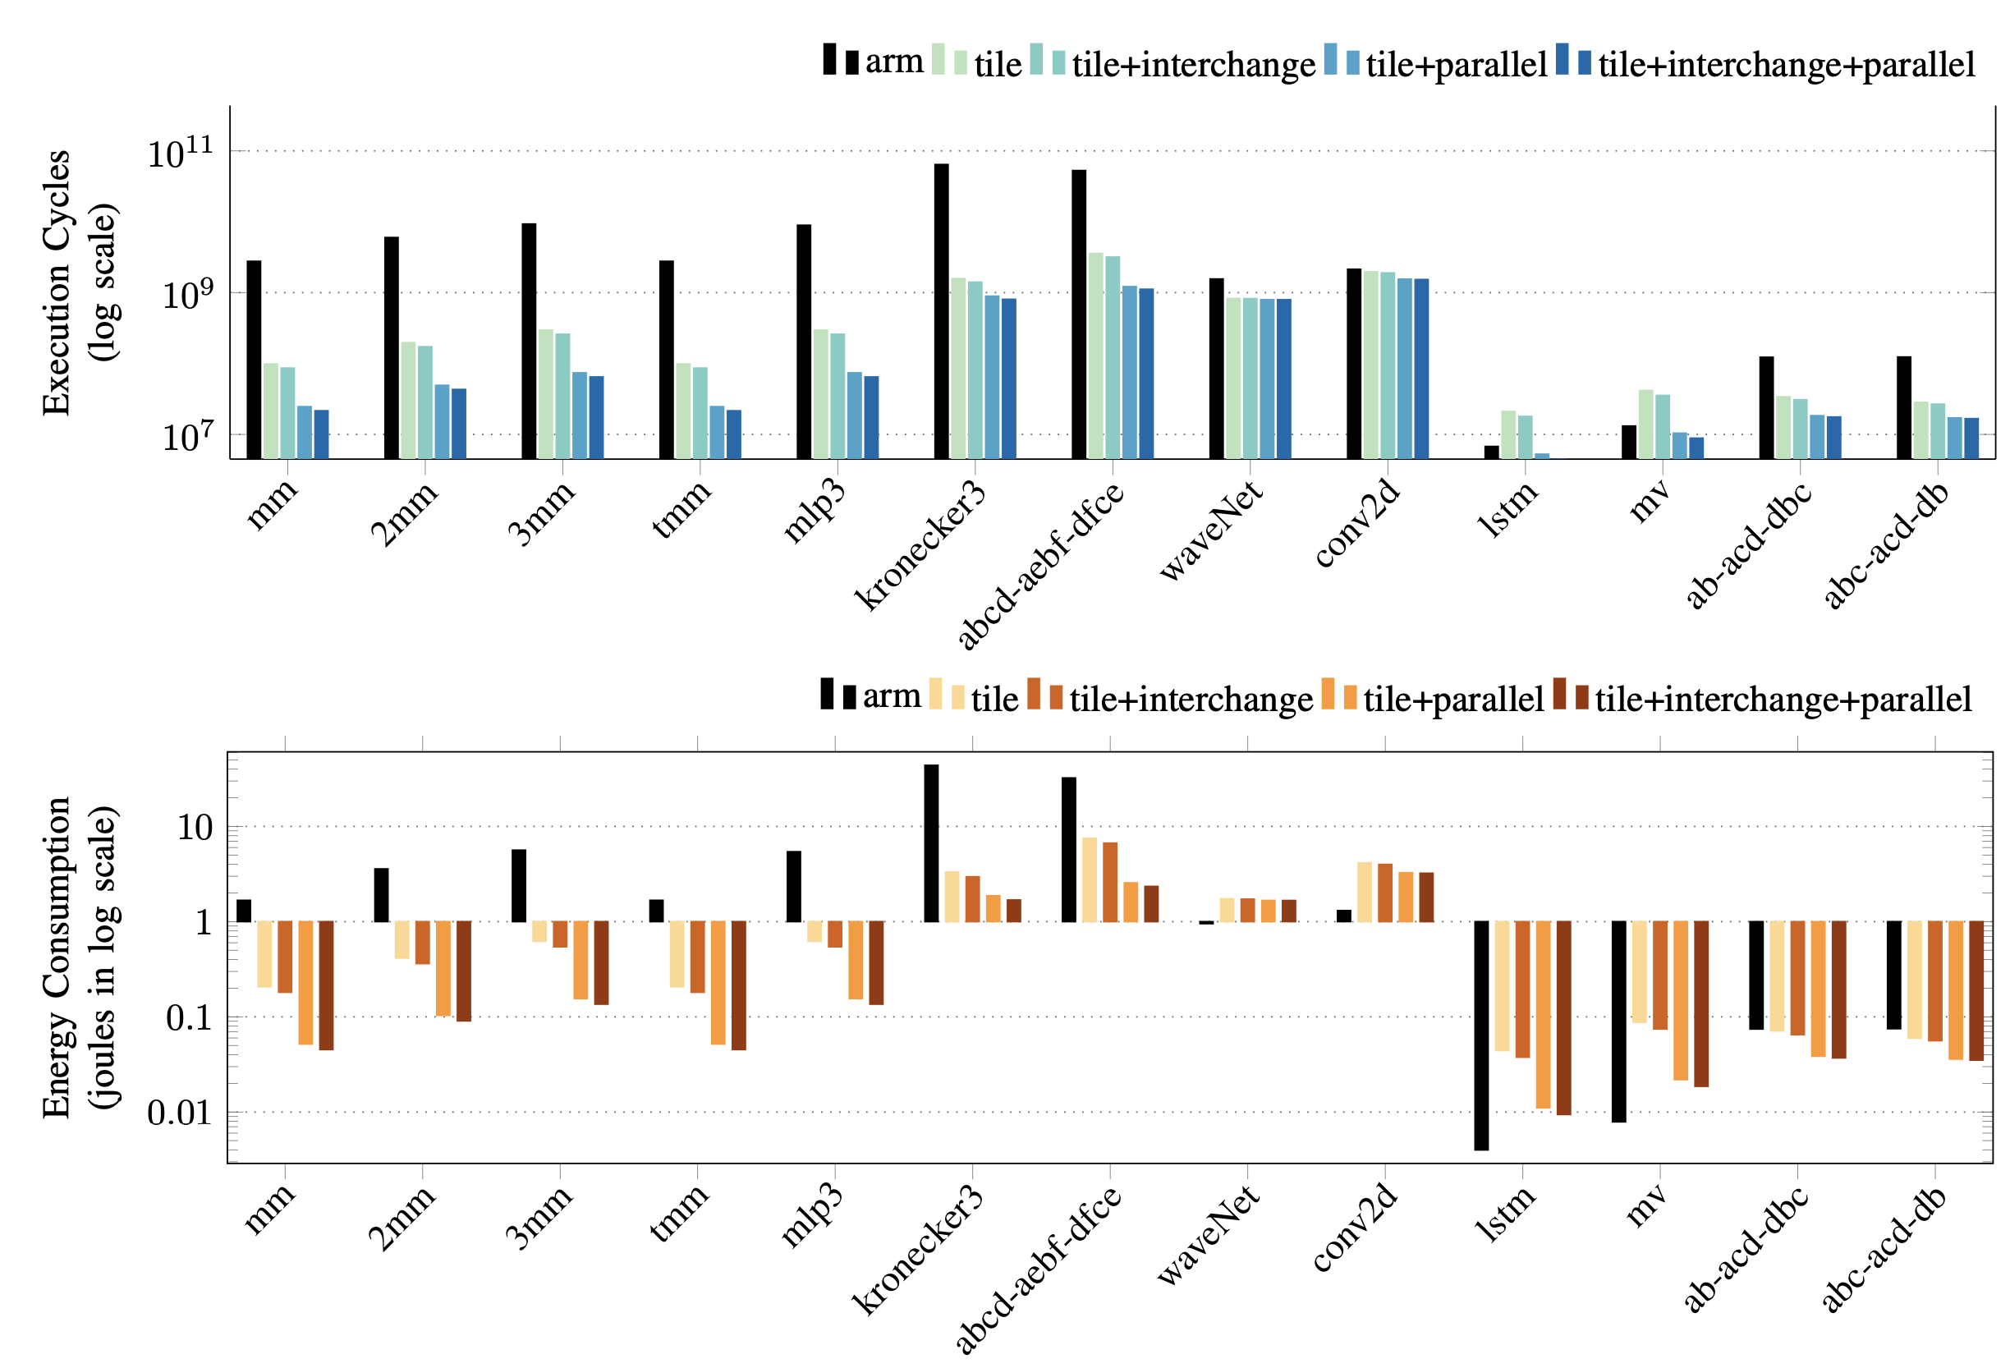
Optimization results: Crossbars beyond matmult
A. Siemieniuk, L. Chelini, A. A. Khan, J. Castrillon, A. Drebes, H. Corporaal, T. Grosser, M. Kong, "OCC: An Automated End-to-End Machine Learning Optimizing Compiler for Computing-In-Memory", In IEEE TCAD, 2021

Slide 38
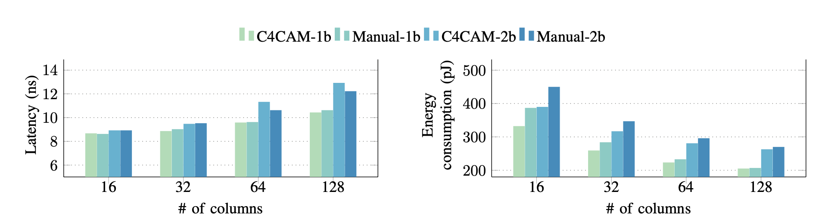
Content addressable memories (CAMs)
NVM-based CAMs: Great for KNNs, One-shot learning, …
CINM support for similarity and CAM arch exploration
Automatic flow from TorchScript matches manual designs
H. Farzaneh, et al. “C4CAM: A Compiler for CAM-based In-memory Accelerators”, eprint arXiv:2309.06418, Sep 2023

Slide 39
Summary
Next generation programming for extreme heteogeneity
Domain-specific abstractions, compilation flows, …
Reconfigurable HW, HBM, data placement, near and in-memory computing
Challenges
Understanding and modeling primitives from down below
Simulators, prototypes in interdisciplinary research efforts
Optimization/DSE: ML? simpler heuristics useful again?
Joint work across stack layers will be key!
Notes:
Programming heterogeneous computing systems is a daunting task which is becoming even more challenging with the advent of emerging, non Von-Neumann computer architectures. The golden age of computer architecture must be thus accompanied by a golden age of research in compilers and programming languages. This talk discusses domain-specific abstractions and languages as a promising avenue to hide the system complexity from non-expert programmers while passing richer information to compilers. Concretely, we will discuss abstractions for tensor expressions as vehicle to optimize for modern reconfigurable hardware, for emerging memory technologies and for emerging in-memory computing. The talk closes with an outlook on other emerging architectures and challenges for high-level compilation.

Slide 40





Thanks! & Acknowledgements
CO4RTM (450944241)
HetCIM (502388442)
https://everest-h2020.eu
GA: 957269
..., and previous members of the group (Norman Rink, Sven Karol, Sebastian Ertel, Andres Goens), and collaborators (J. Fröhlich, I. Sbalzarini, A. Cohen, T. Grosser, T. Hoefler, H. Härtig, H. Corporaal, C. Pilato, S. Parkin, P. Jääskeläinen, J-J. Chen, A. Jones)
BMBF (01IS18026A-D)
Notes:
cfaed is co-funded by the Saxon Ministry of Science, Culture and Tourism.

Slide 41
References
[TMSCS’18] J. Castrillon, et al. "A Hardware/Software Stack for Heterogeneous Systems", In IEEE Transactions on Multi-Scale Computing Systems, 2018
[RWDSL’18] N. A. Rink, et al. “CFDlang: High-level code generation for high-order methods in fluid dynamics”. RWDSL’18.
[GPCE’18] A. Susungi, et al. "Meta-programming for cross-domain tensor optimizations" GPCE’18, 79-92.
[Array’19] N.A. Rink, N. A. and J. Castrillon. “TeIL: a type-safe imperative Tensor Intermediate Language”, ARRAY’19, pp. 57-68
[DATE’21] C. Pilato, et al. "EVEREST: A design environment for extreme-scale big data analytics on heterogeneous platforms”, DATE 2021
[FPGAHPC’21] K. F. A. Friebel, et al. "From Domain-Specific Languages to Memory-Optimized Accelerators for Fluid Dynamics", FPGA for HPC @ IEEE Cluster 2021
[TRETS’22] S. Soldavini, K. F. A. Friebel, M. Tibaldi, G. Hempel, J. Castrillon, and C. Pilato. “Automatic Creation of High-Bandwidth Memory Architectures from Domain-Specific Languages: The Case of Computational Fluid Dynamics”. In: ACM TRETS, Sept. 2022.
[HEART’23] K. F. A. Friebel, J. Bi, J. Castrillon, "BASE2: An IR for Binary Numeral Types" (to appear), In ACM HEART 2023
[DATE’23] G. Korol, M. G. Jordan, M. B. Rutzig, J. Castrillon, A. C. Schneider Beck, "Pruning and Early-Exit Co-Optimization for CNN Acceleration on FPGAs", DATE 2023
[ISLVLSI’23] G. Korol, M. G. Jordan, M. B. Rutzig, J. Castrillon, A. C. Schneider Beck, “"Design Space Exploration for CNN Offloading to FPGAs at the Edge", ISVLSI 2023
[ICAL’19] Khan, et al. "RTSim: A Cycle-accurate Simulator for Racetrack Memories", In IEEE Computer Architecture Letters, 2019
[IPROC’20] R. Bläsing, et al. "Magnetic Racetrack Memory: From Physics to the Cusp of Applications within a Decade", In Proceedings of the IEEE, vol. 108, no. 8, pp. 1303-1321, Mar 2020.
[LCTES’19] A. A. Khan, et al. "Optimizing Tensor Contractions for Embedded Devices with Racetrack Memory Scratch-Pads”, Proceedings of the 20th ACM SIGPLAN/SIGBED LCTES’19, pp. 5-18, Jun 2019
[TECS’20] A. A. Khan, et al. “Optimizing Tensor Contractions for Embedded Devices with Racetrack and DRAM Memories”. ACM TECS 2020
[TACO’19] Khan, et al. “ShiftsReduce: Minimizing Shifts in Racetrack Memory 4.0”, ACM TACO 2019
[TCAD’20] A. A. Khan, et al., "Polyhedral Compilation for Racetrack Memories", In IEEE TCAD’20, vol. 39, no. 11, pp. 3968-3980, Oct 2020.
[DAC’21] C. Hackert, “BLOwing Trees to the Ground: Layout Optimization of Decision Trees on Racetrack Memory”, DAC 2021
[CINM’23] A. Khan et al, "CINM (Cinnamon): A Compilation Infrastructure for Heterogeneous Compute In-Memory and Compute Near-Memory Paradigms", arXiv, Aug 2023
[TCAD’21] A. Siemieniuk, et al. "OCC: An Automated End-to-End Machine Learning Optimizing Compiler for Computing-In-Memory", IEEE TCAD, 2021
[C4CAM’23] H. Farzaneh, et al. “C4CAM: A Compiler for CAM-based In-memory Accelerators”, eprint arXiv:2309.06418, Sep 2023

Slide 42
Back-up

Slide 43
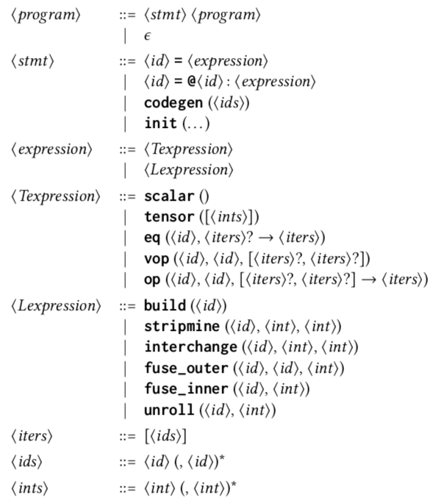
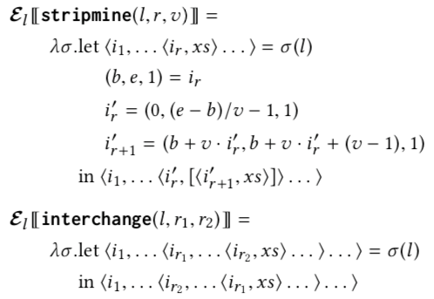
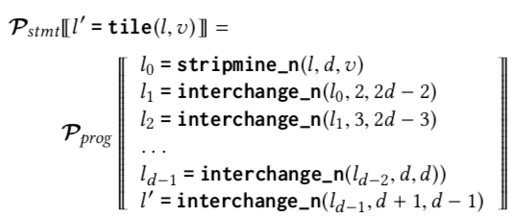
TeML: Meta-programming for tensor optimizations
Generalize for cross-domain tensor expressions
Formal semantics and composition of transformations
Formally defined transformation primitives
Higher-level transformations via composition
A. Susungi, et al. "Meta-programming for cross-domain tensor optimizations" GPCE’18, 79-92
Notes:
No leak abstraction: in TF/TACO/TVM intermediate language it is possible to write code that ends up generating segfaults!
Strip-mining: turn a one dimensional loop into two dimensions. The inner dimension could be vectorized.

Slide 44
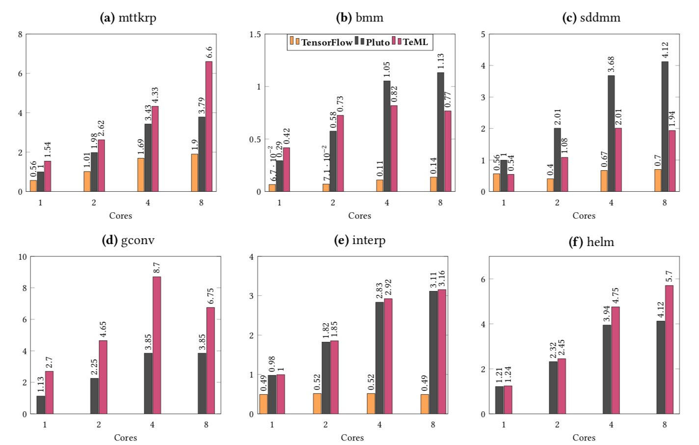
Meta-programming for optimizations: Results
Performance of Pluto could be reproduced
Higher abstraction → more optimization potential
A. Susungi, et al. "Meta-programming for cross-domain tensor optimizations”, GPCE’18, 79-92
Notes:
Baseline: Sequential Single Core C implementation
Sometimes worse than pluto?
We can get as good as pluto (we showed that we can reproduce all the polyhedral optimizations that pluto does)
Here we were showcasing several optimizations (not possible with pluto). Sometimes they work, some times they don’t
Take comparison with TensorFlow with a pinch of salt

Slide 45


TeIL: Formal language – added value
A = placeholder((m,h), name='A')
B = placeholder((n,h), name='B')
k = reduce_axis((0, h), name='k')
C = compute((m, n), lambda i, j:
sum(A[k, i] * B[k, j], axis=k))
Core common to multiple tensor languages
Index-free notation and strong type system
Provably no out-of-bound accesses
$$C_{ij}=\sum_{k=1}^{h}{A_{ki}B_{kj}}$$
N.A. Rink, N. A. and J. Castrillon. “TeIL: a type-safe imperative Tensor Intermediate Language”, ARRAY’19, pp. 57-68
Notes:
Example of abstraction leak: write correct C and get an error in assembly. Who can debug that?
Exmaple from TVM
Sample snippet may lead to a segfault or produce wrong data, buffer overflows

Slide 46
Generalization: RTM optimizing compiler
Jointly optimize layout and operation scheduling
Interplay with other (polyhedral) loop optimizations: Tiling, fusion, …
Khan, et al. "Polyhedral Compilation for Racetrack Memories”. IEEE TCAD 2020
Notes:
Mention this was with Torsten!

Slide 47

Emerging memories and in-memory computing
Compute in-place, avoid data movement, transformations to match primitives
In-PCM Computing
In-RTM Computing
Y. Wang et al., "An Energy-Efficient Nonvolatile In-Memory Computing Architecture for Extreme Learning Machine by Domain-Wall Nanowire Devices," in IEEE Transactions on Nanotechnology, 2015.
Joshi, Vinay, et al. "Accurate deep neural network inference using computational phase-change memory." Nature Communications 11.1 (2020): 1-13.
Parkin, Stuart SP, Masamitsu Hayashi, and Luc Thomas. "Magnetic domain-wall racetrack memory." Science 320.5873 (2008): 190-194.

Slide 48
Example: Hyper dimensional computing (HDC)
HDC: Embed data in 10 k-dimensions – Von-Neuman Bottleneck!
Khan, A. A., Ollivier, S., Longofono, S., Hempel, G., Castrillon, J., & Jones, A. K. (2022). Brain-inspired Cognition in Next Generation Racetrack Memories. In ACM TECS 2022
Notes:
Cannot go into detail: Just to show what is possible and what kind of applications can profit from CIM.

Slide 49


Example: Hyper dimensional computing (HDC)
~6x faster and 5.3x less energy over FPGA accelerator
Khan, A. A., Ollivier, S., Longofono, S., Hempel, G., Castrillon, J., & Jones, A. K. (2022). “Brain-inspired Cognition in Next Generation Racetrack Memories” In ACM TECS 2022
Notes:
Cannot go into detail: Just to show what is possible and what kind of applications can profit from CIM.

